Slide 1
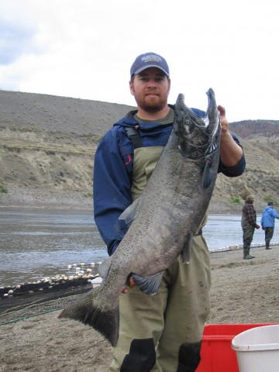
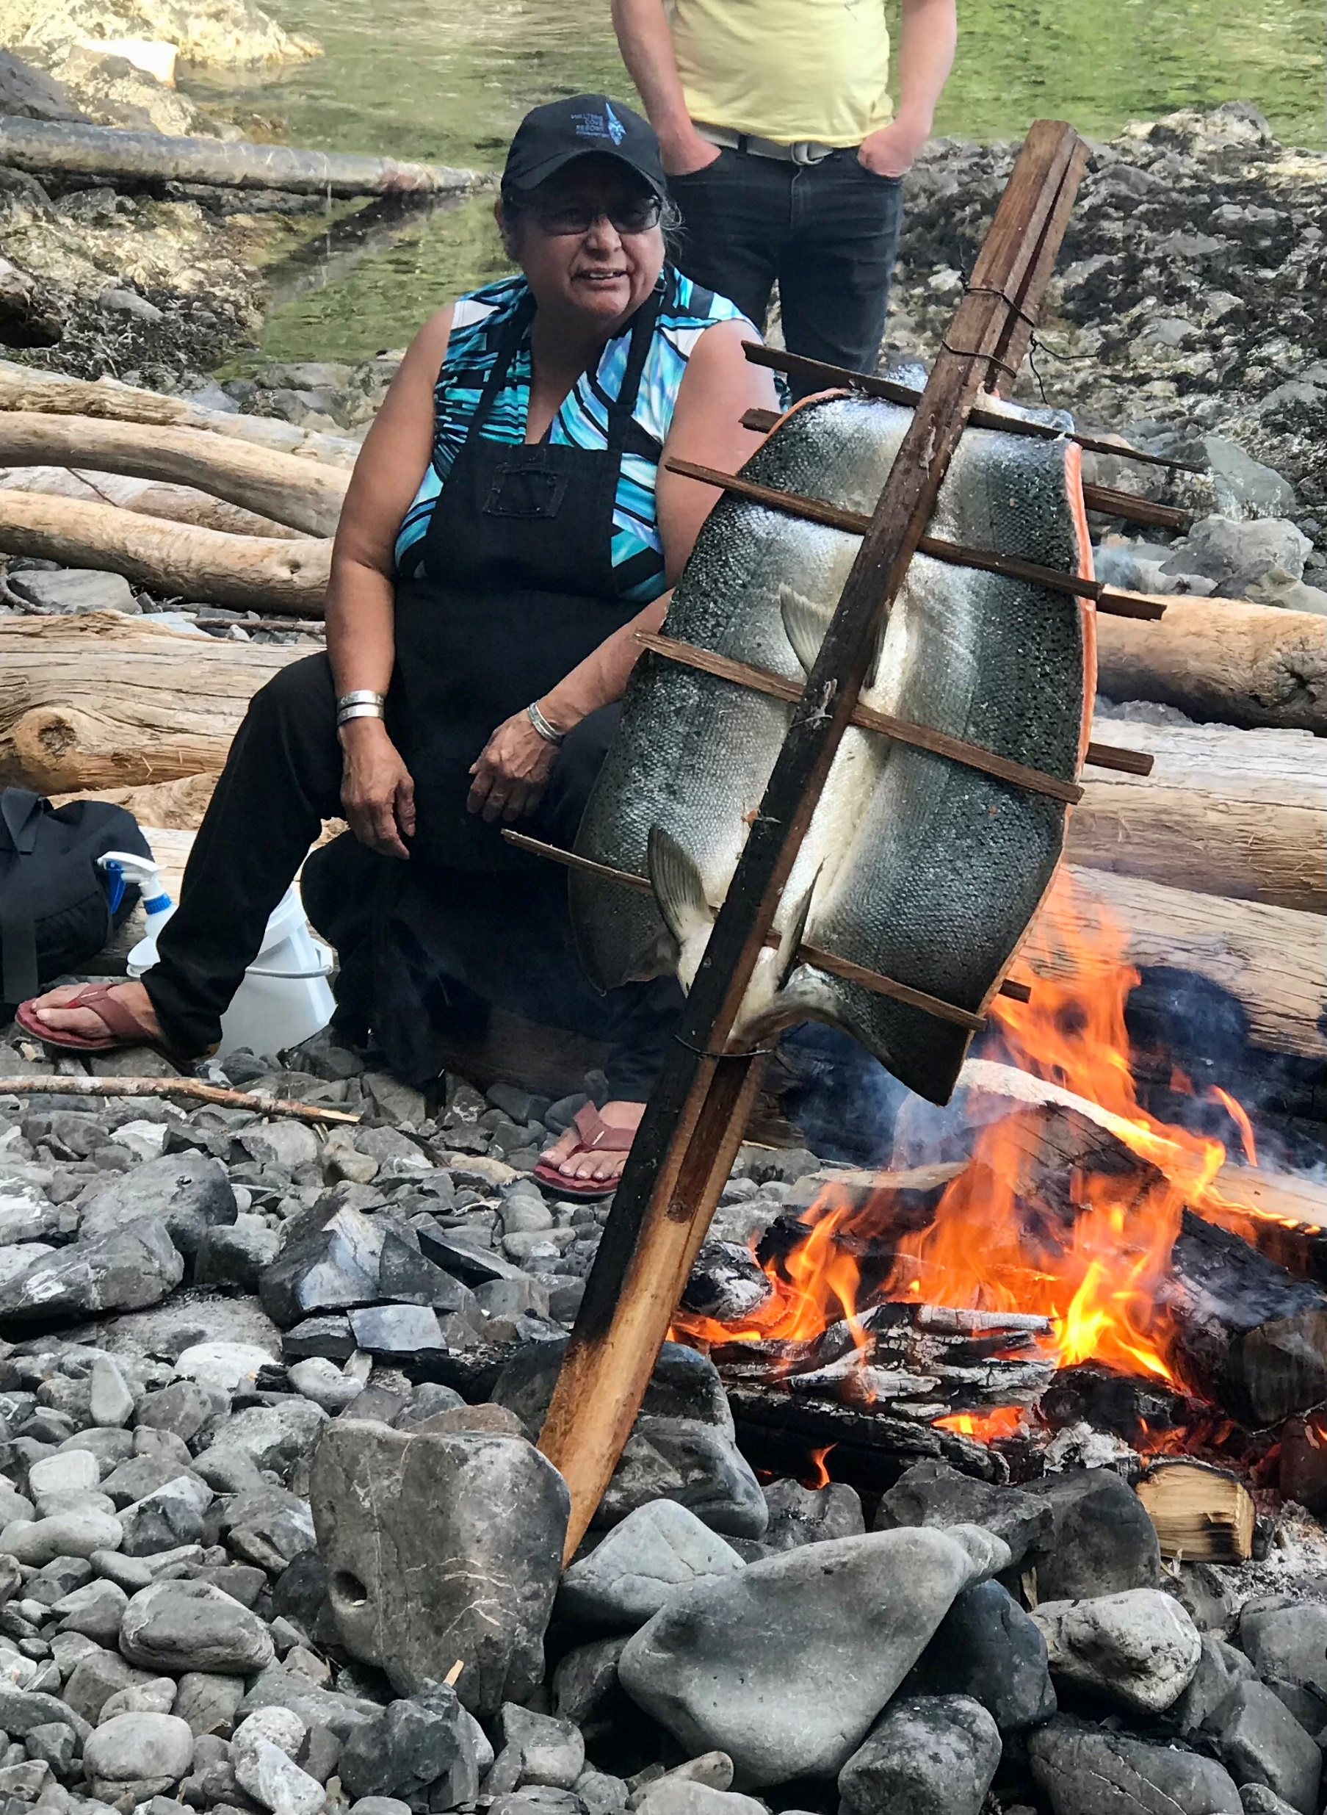
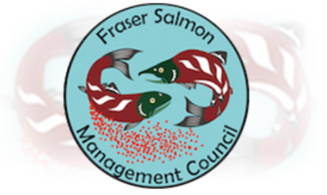
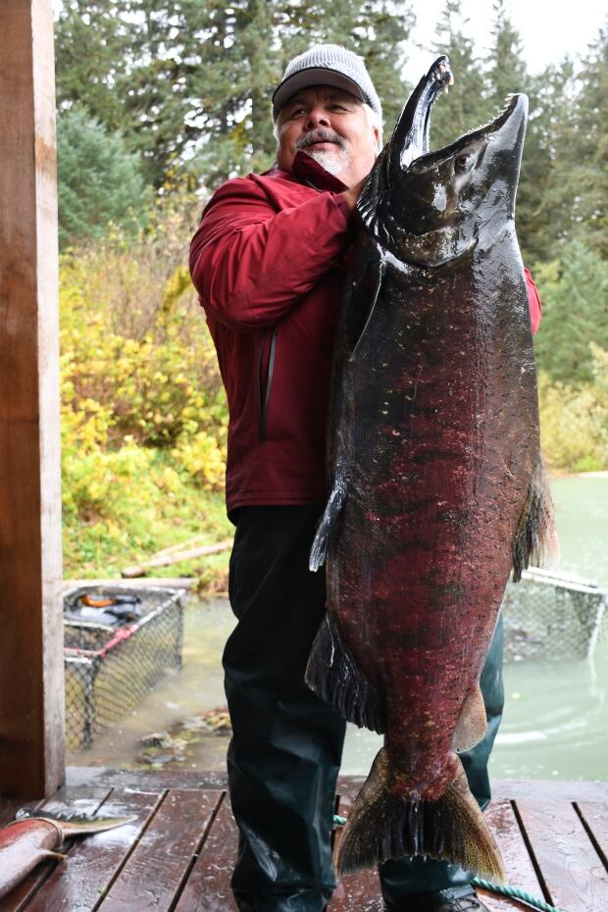
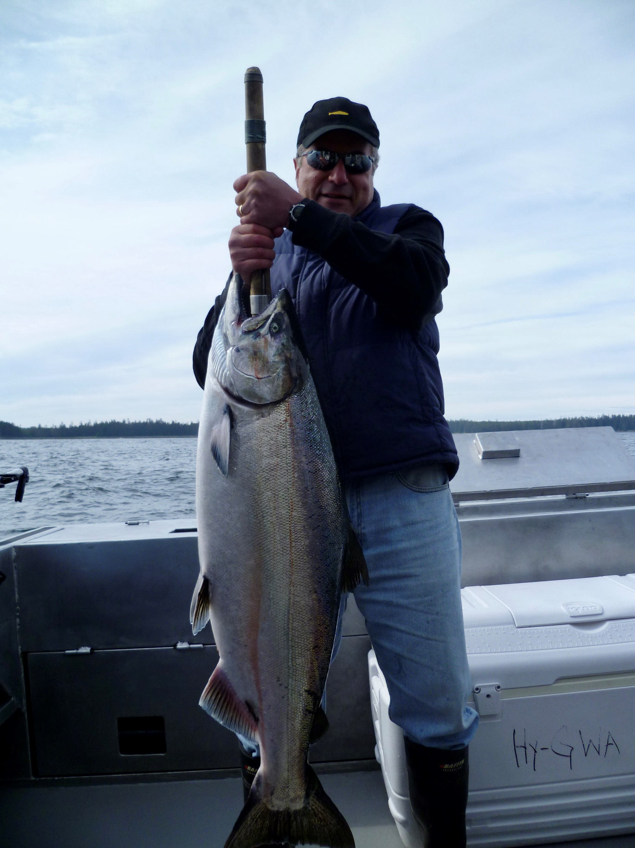
CRRI: Chinook Recovery and Restoration Initiative Vancouver Workshop – Dec. 11-12, 2023
Chinook Salmon in BC/Yukon:
A change is coming, you can’t deny it!
“Me7 wéwlem-kt wel me7 yews” - “Fishing for our Future.”

Slide 2
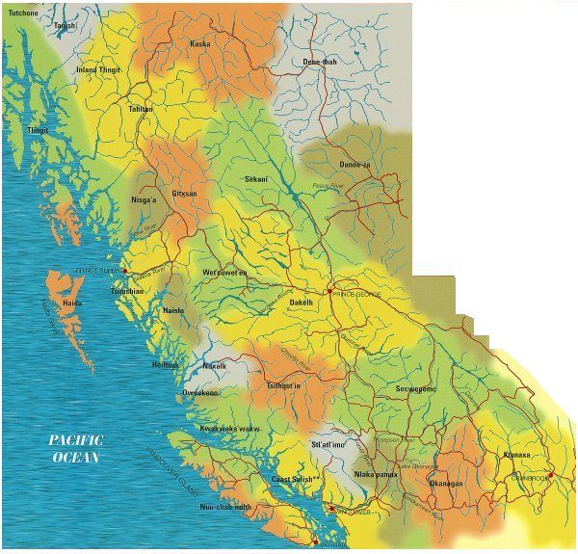
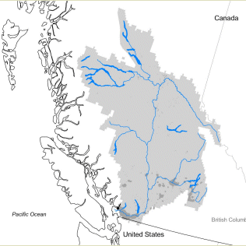
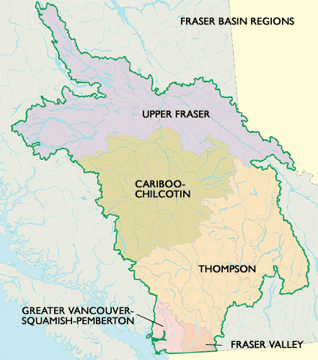
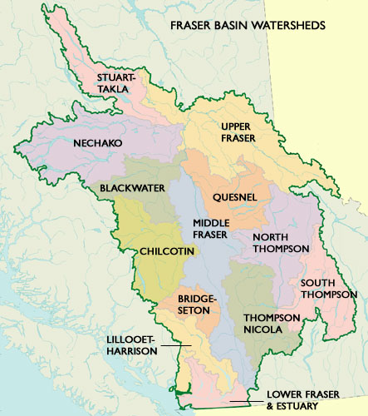
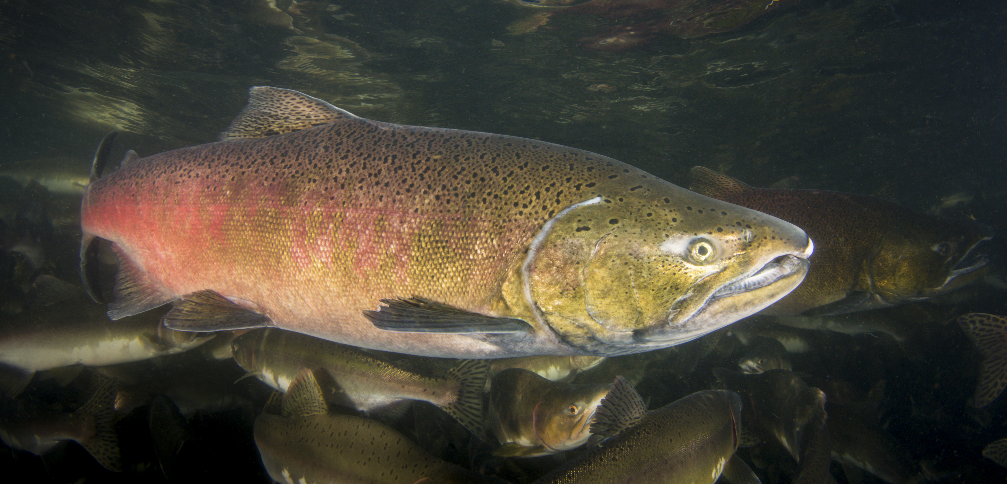
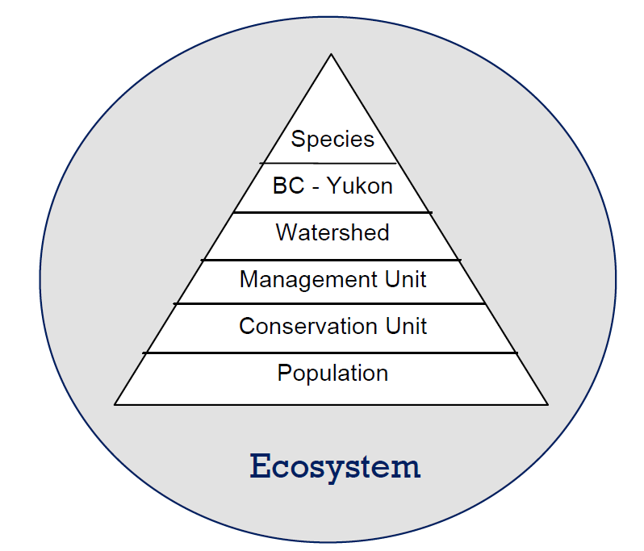
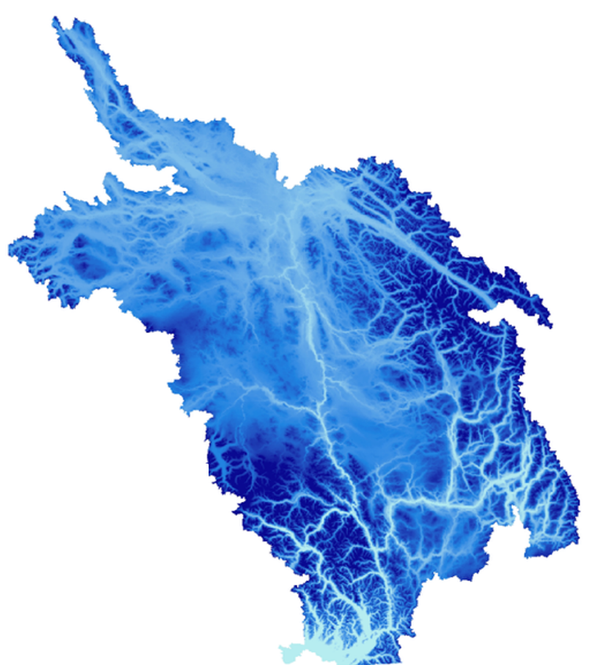
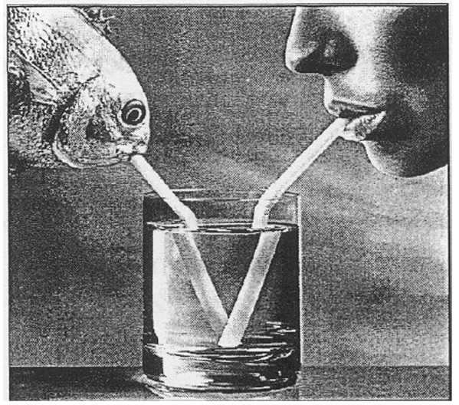
Boundaries
Temporal: Are you suffering from shifting baseline syndrome?
A shifting baseline is a type of change to how a system is measured, usually against previous reference points.
Are Chinook rebuilding targets based on the salmon population 2,000 years ago? the year 1492?, 1912-1914 (aka Hell’s Gate), 1960? last year?
Spatial
Fraser Chinook rear throughout the watershed, including non-natal habitats, and within estuaries and marine habitats
Freshwater migration environments, and access to critical rearing habitats have in many cases been seriously degraded.
“Think like a watershed”. River system stability is linked to biodiversity.
Moore, J.W., et al. 2015. Emergent stability in a large free-flowing watershed. Ecology 96: 340-347
Need to manage the whole as well as the pieces
Local decisions made for land and water and salmon management affect river stability

Slide 3
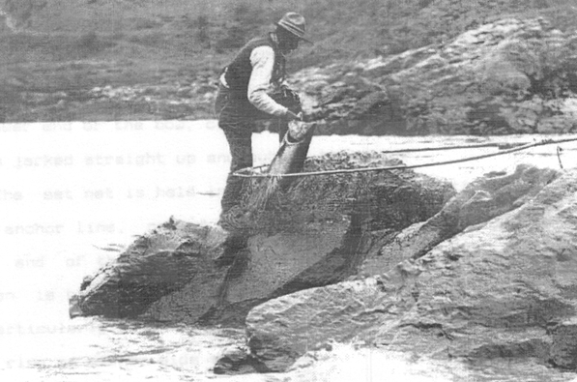
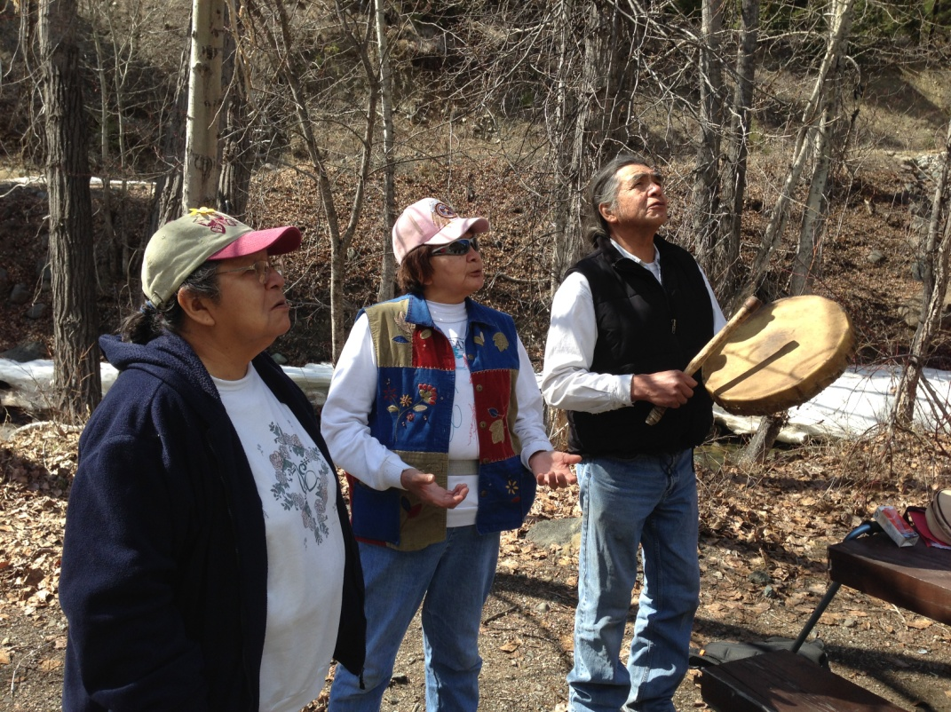
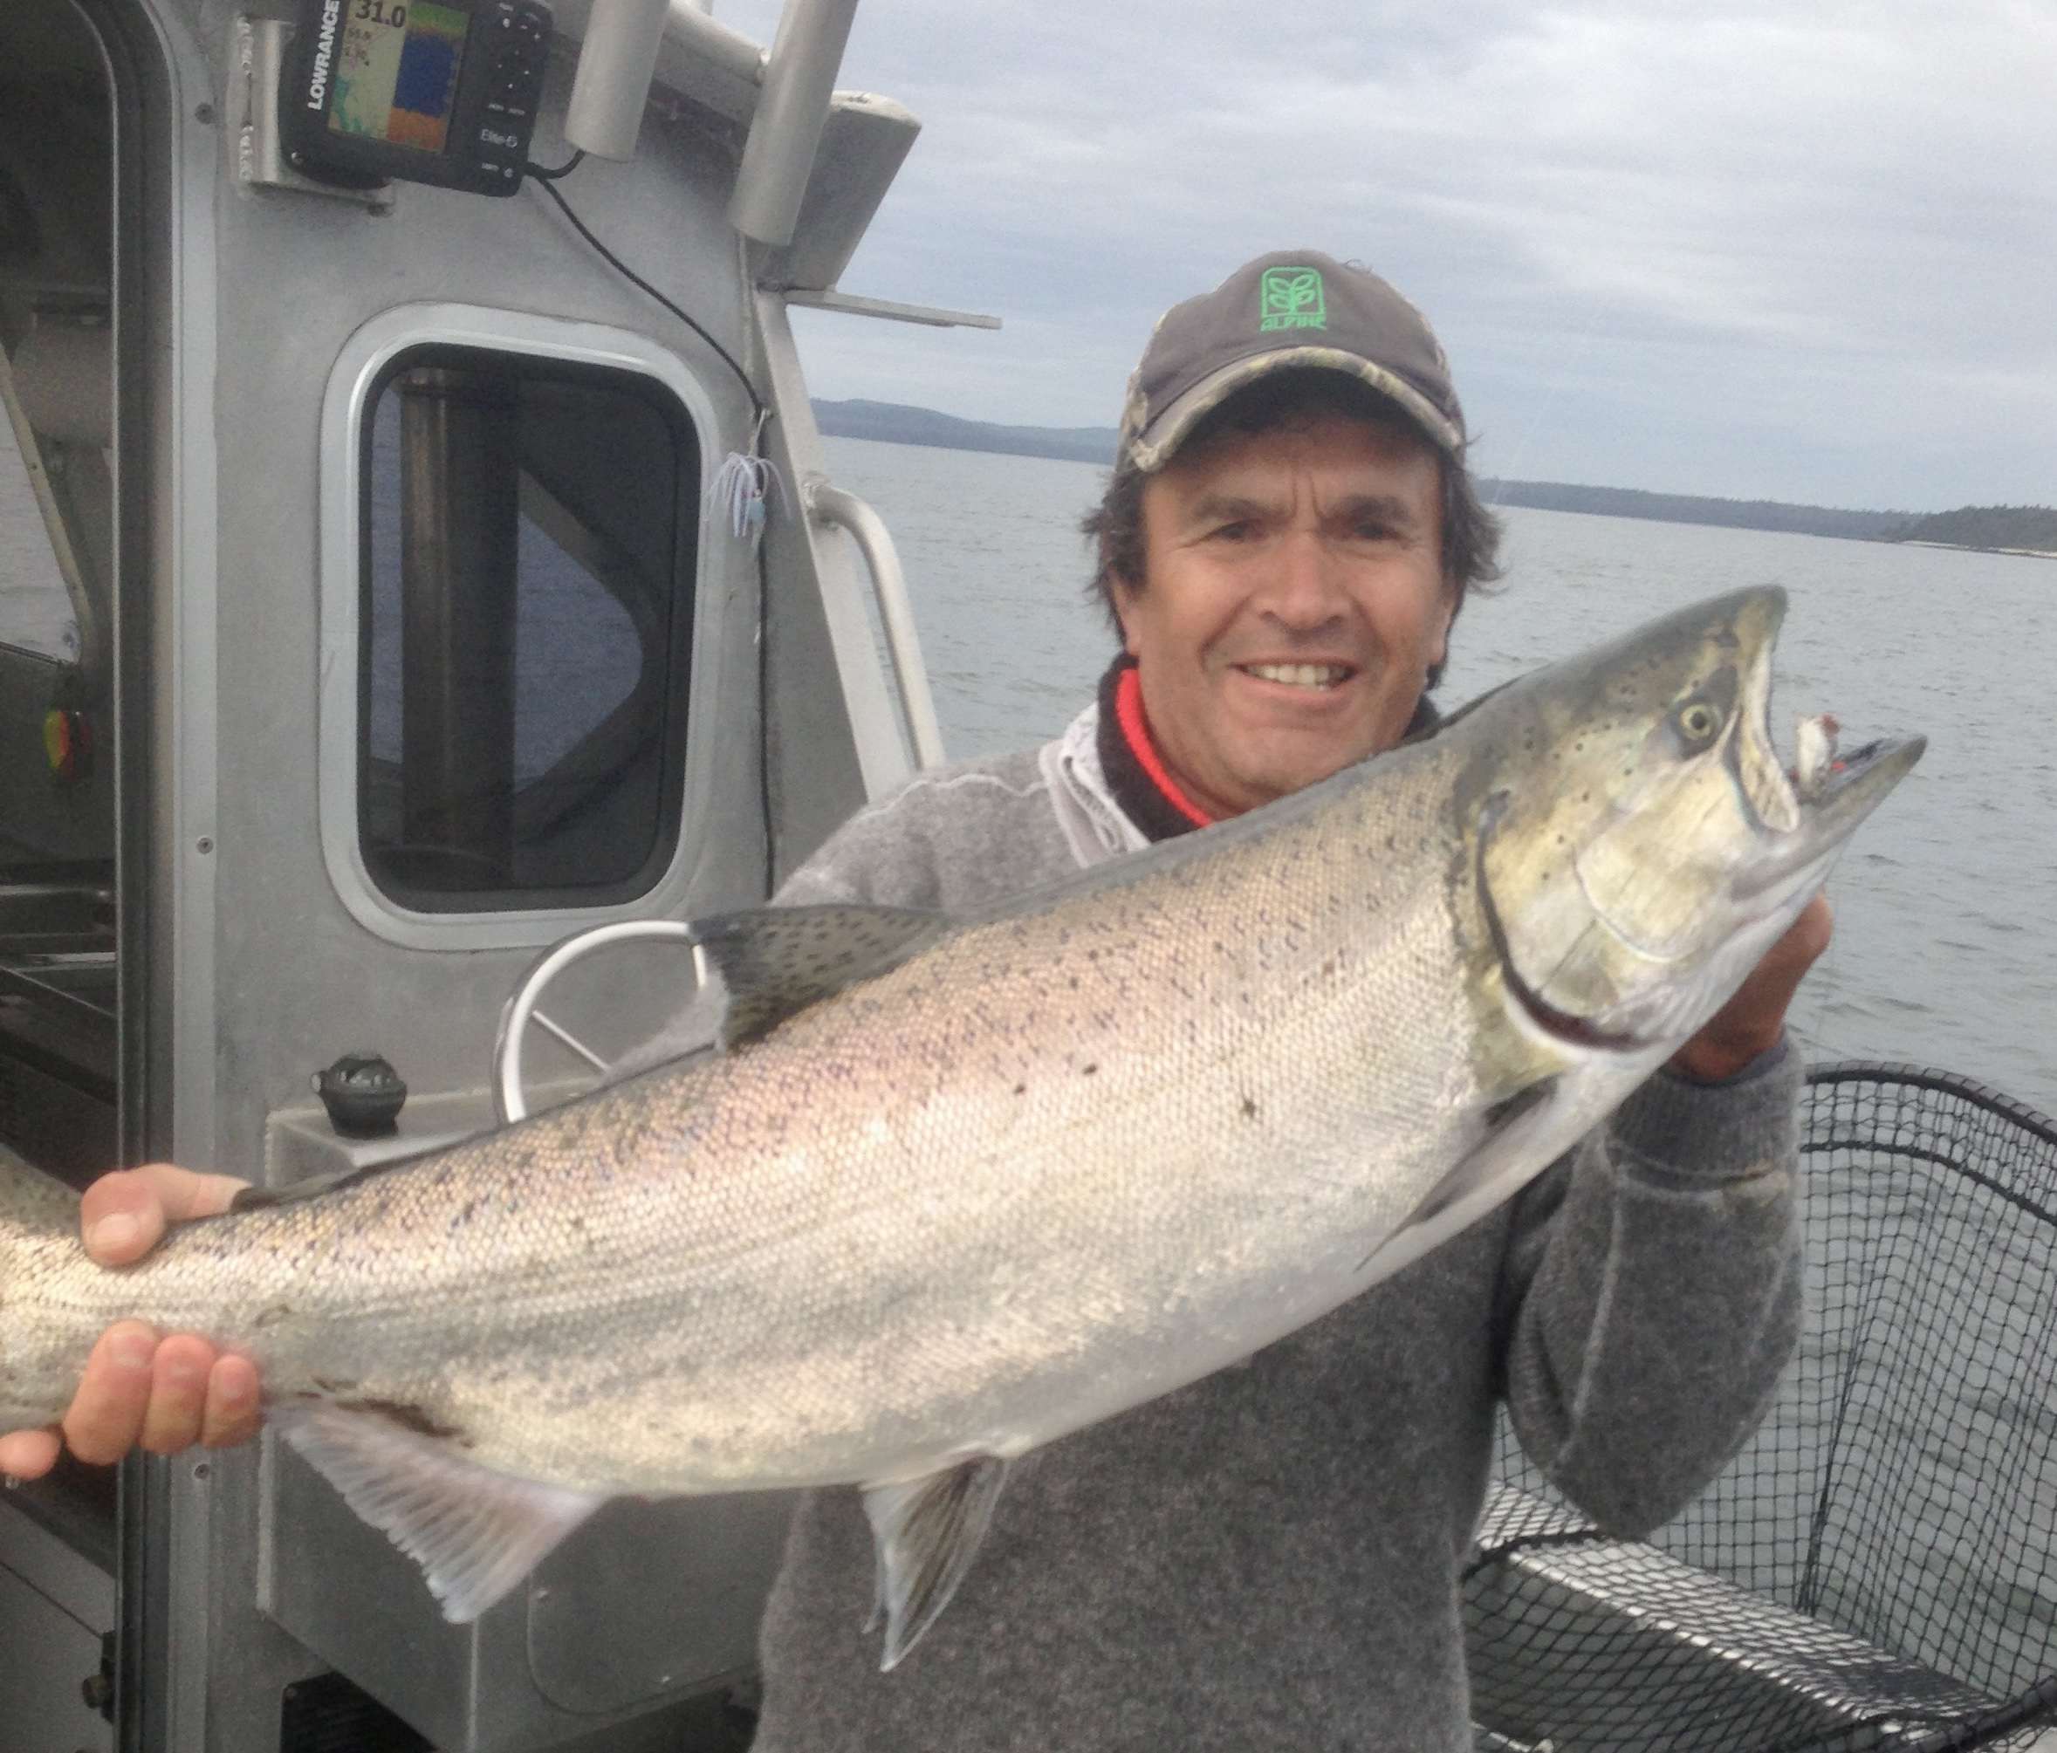
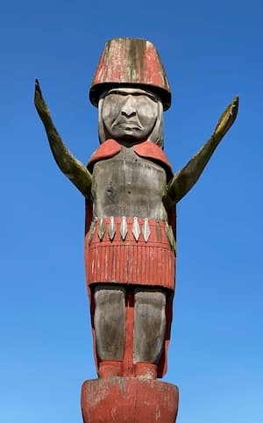
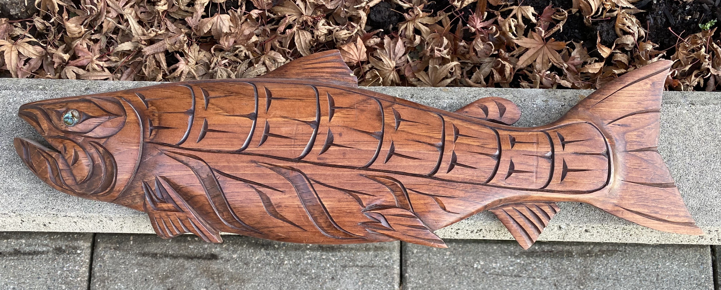
Indigenous Knowledge
Salmon are the focus of numerous songs, dances and legends and serve as a staple item at ceremonies and other important events. Traditionally, First Salmon ceremonies occurred in April-May following the start of the Chinook run. These fish are considered to be a form of medicine and are provided preferentially to Elders.
Typically, IK is treated as an “add-on” to the technical analysis, and is often not included in a meaningful way, essentially a “science first” approach.
To develop a truly co-operative venture, it is necessary to incorporate IK during the initial scoping and objective–setting stages for Chinook rehabilitation.
For decades, academcs have attempted to “fuse” IK and scientific knowledge to provide a method for integrating information for planning and decision-making purposes. During previous work conducted on behalf of Fraser First Nations, it was concluded that this approach is flawed and that it is preferable to consider the 2 information sources separately so that one can inform the other and vice versa.

Slide 4
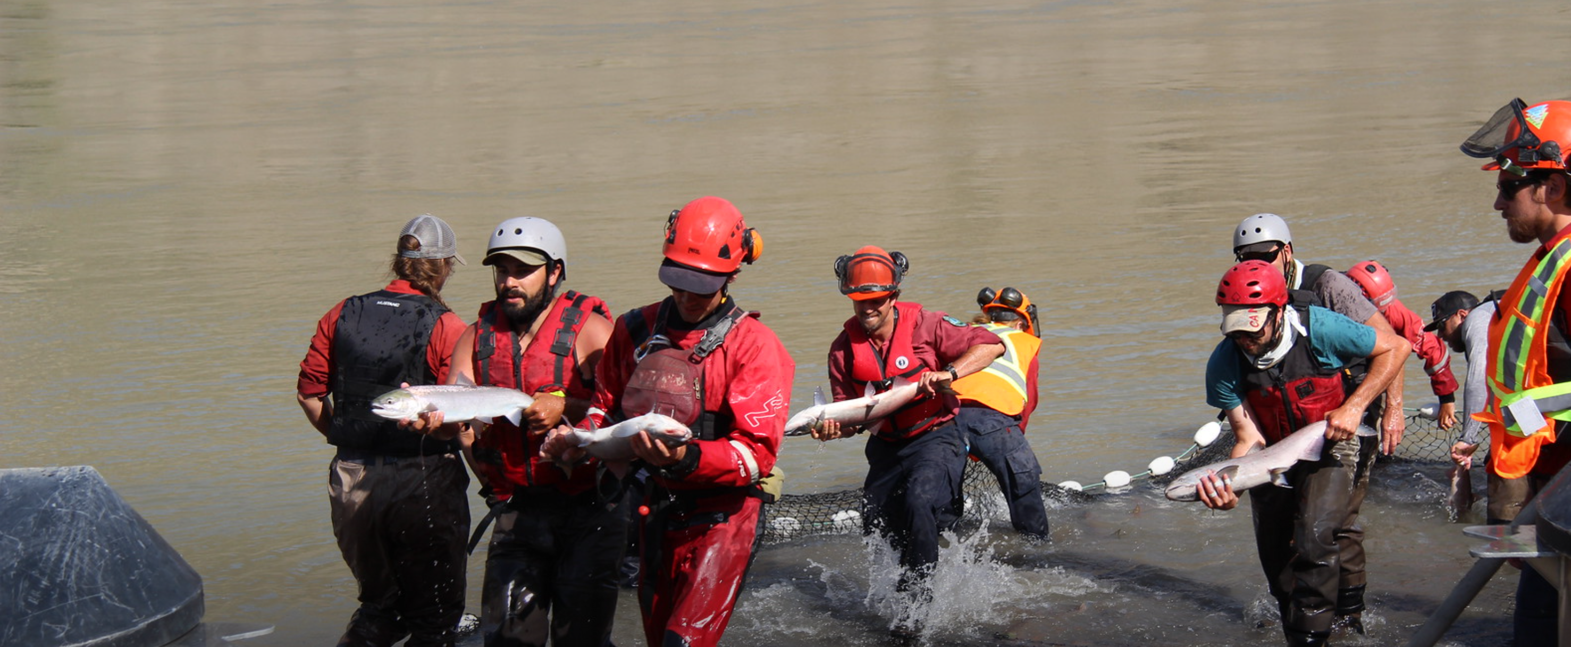


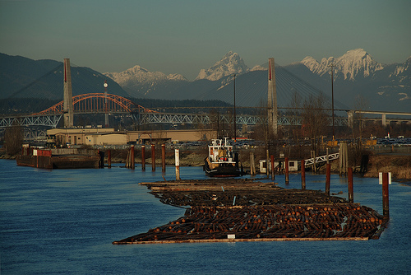

Environmental Vulnerability Assessments
Big Bar – salmon migration blockage
Discovery Passage
Salmon Farm Interactions
Roberts Bank – Habitat Assessment
Climate Change
Lower Fraser River Habitat Quality
DL: Environmental Vulnerability Assessments
Upland
Climate Change
Cumulative Effects
Nechako Reservoir Hydropower production

Slide 5
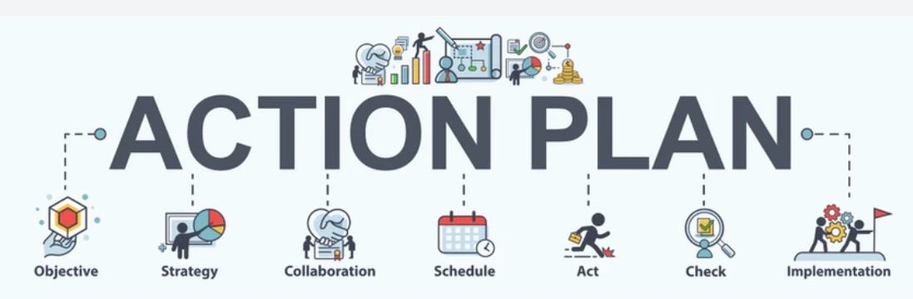
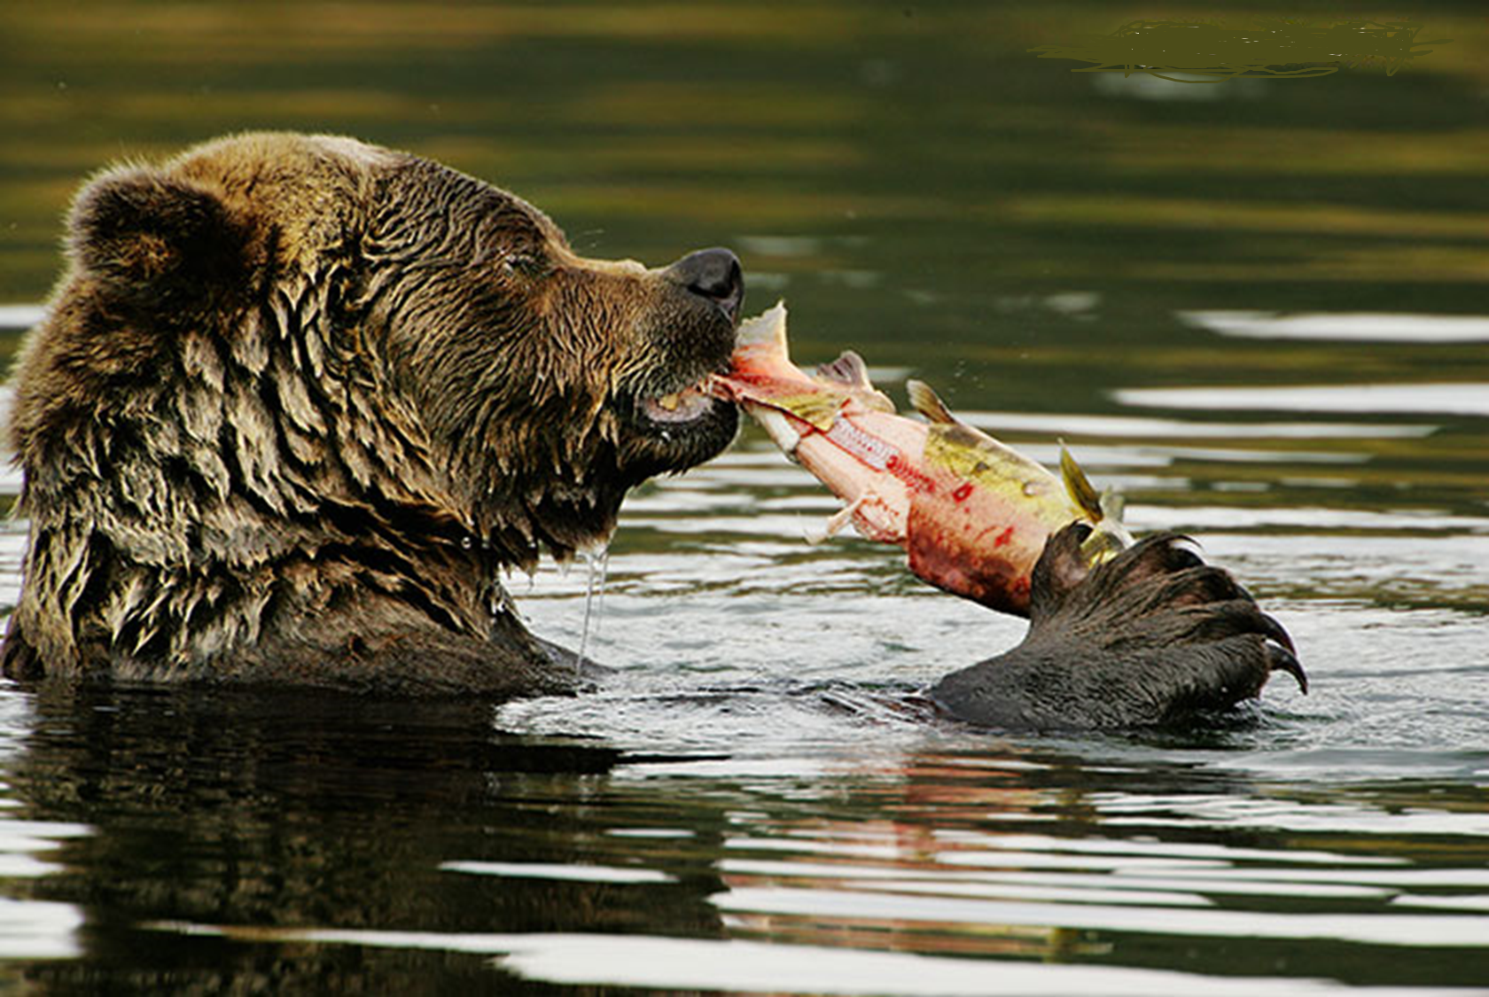
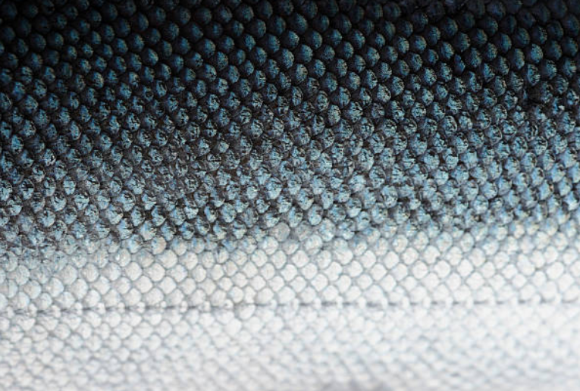

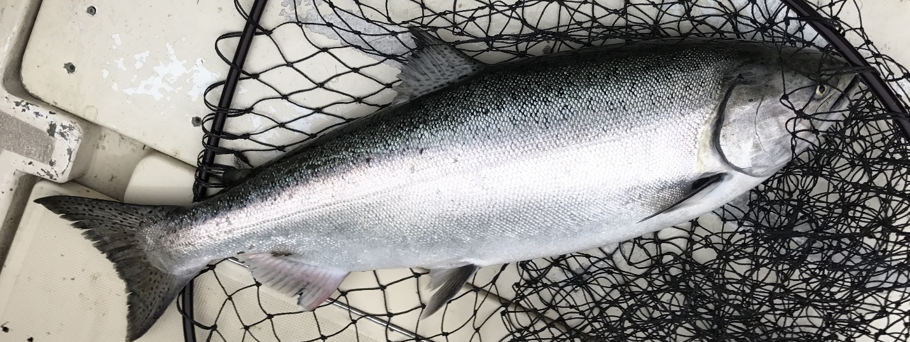
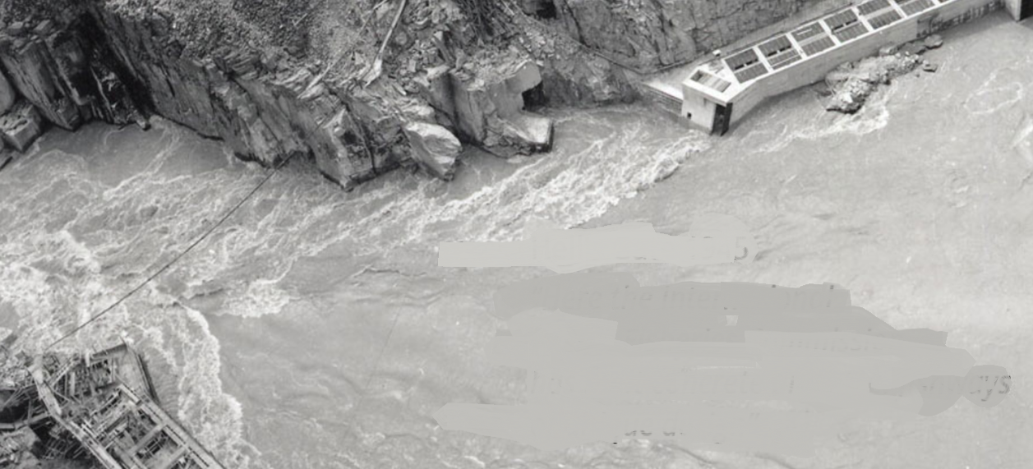
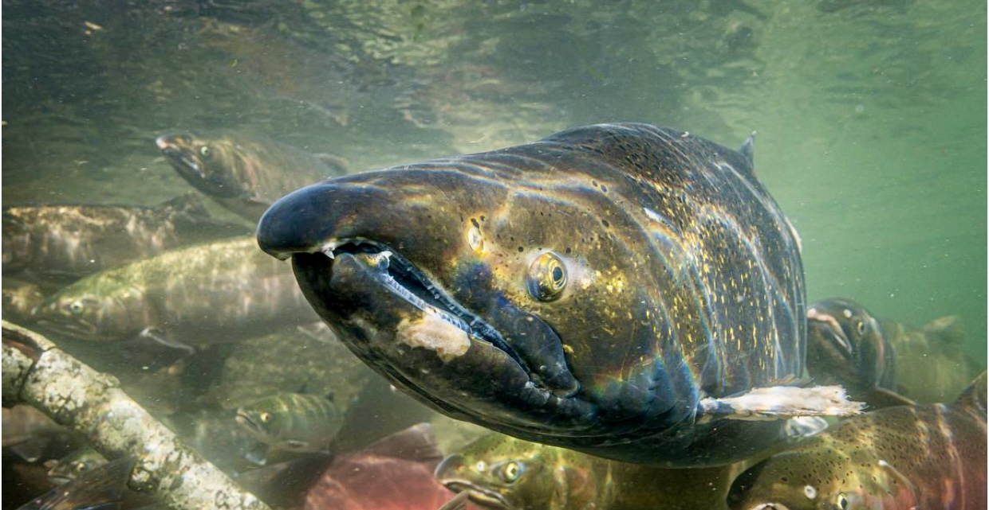
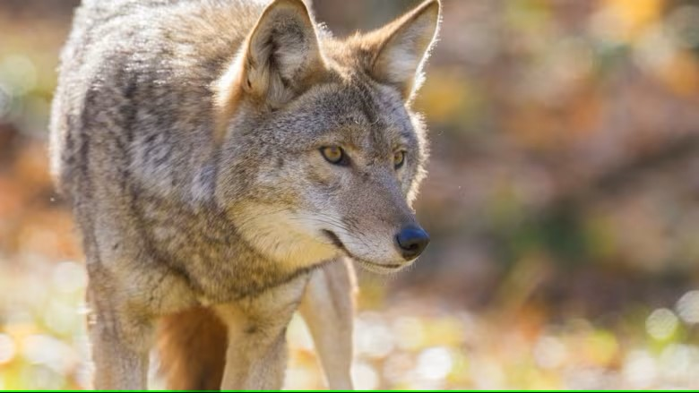

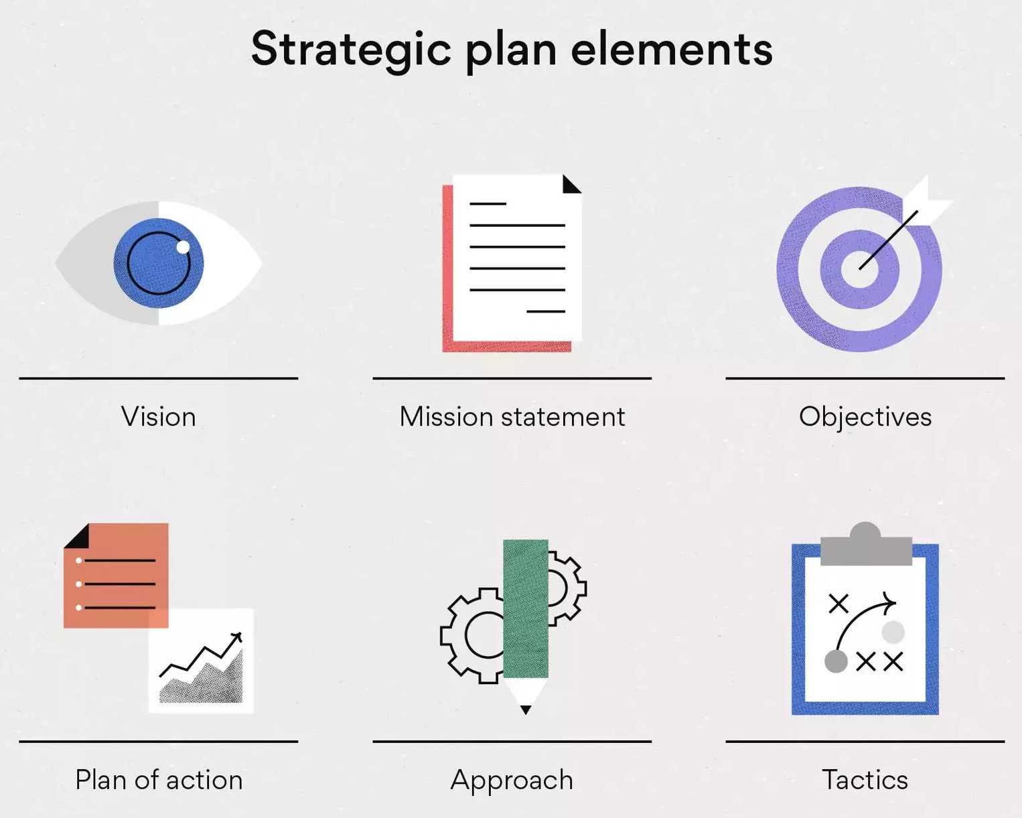
Three Levels of Strategic Planning: Regional, Local and Site-Specific
Regional Planning Tools
    Structured Decision Making
    Priority Threat Management
    Recovery Potential Analysis
    Salmon Enhancement
    Risk Assessment Methodology and Adaptive Management
SCIENCE
Science
  Local planning and implementation of specific Chinook rehabilitation projects
Hell’s Gate 1945
MANAGEMENT
3. Strategic and co-ordinated rehabilitation activities

Slide 6


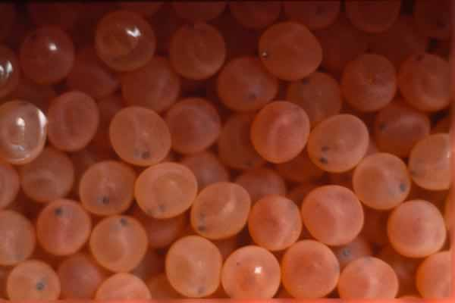


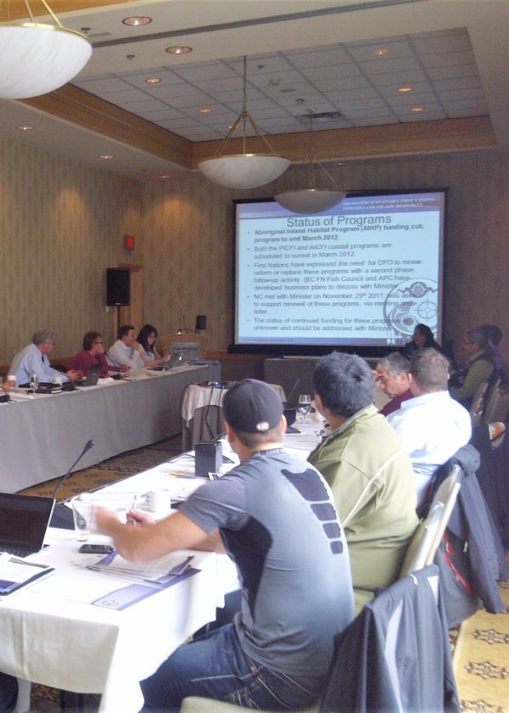
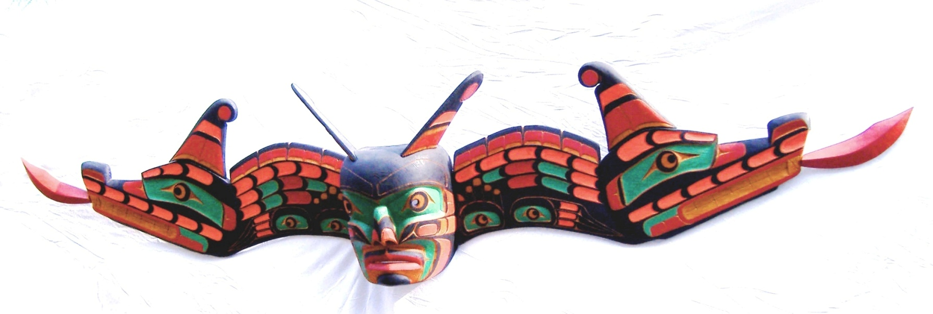
Winning Conditions for Chinook Rehabilitation
Top Down
Top Down
Bottom Up
Bottom Up
Integration of top-down and bottom-up approaches
Develop the context
Commitment to Continuity
Develop partnerships and leverage rebuilding activities with those of other parties
Integrated strategic plan and road map for effective rebuilding
Making It Work
Tools
Structured Decision Making
Priority Threat Management
Recovery Potential Analysis
Salmon Enhancement
Risk Assessment Methodology
Adaptive Management
Regional Planning vs Project Specific
Take home messages: Top Down vs. Bottom Up

Slide 7

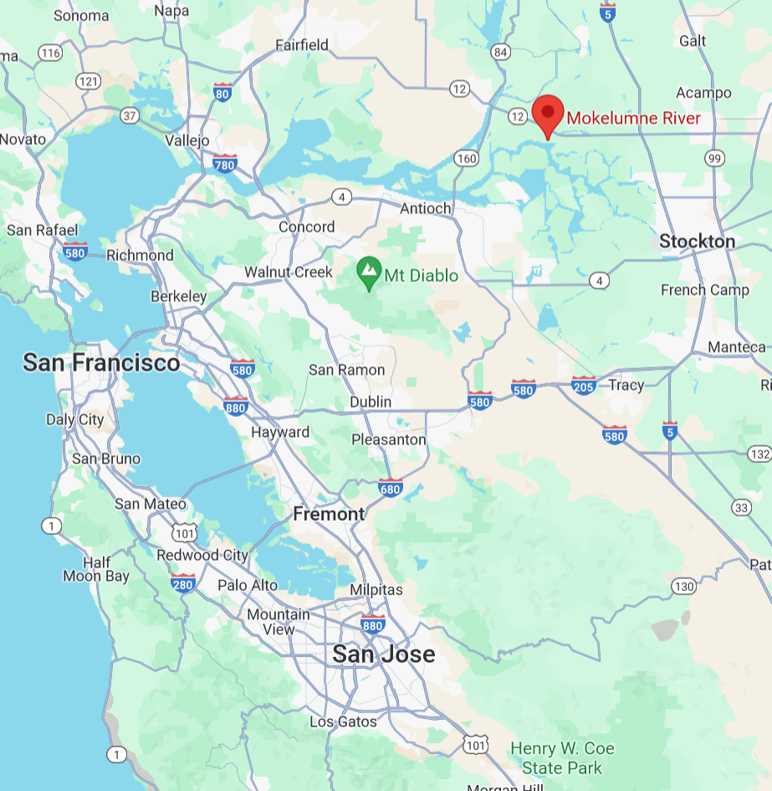
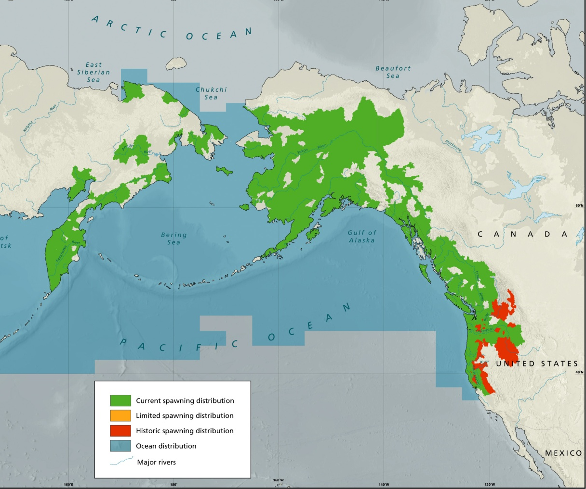


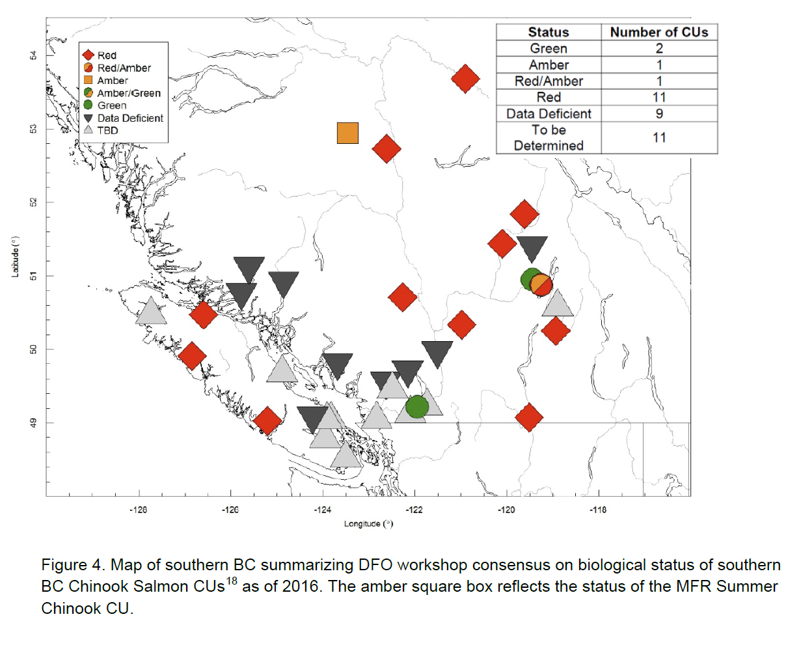
The Good, the Bad and the Ugly
The Good
Some Chinook are doing well e.g. fall run in Mokelumne River (California) set 80-year record of 20,000 fish in 2023
Many examples of collaboration and forward-looking Chinook projects
Many Chinook runs are distributed in southern (warmer) habitats in Washington, Oregon, Idaho and California. This suggests that there may be scope for BC Chinook to survive warmer conditions due to climate change.
    Lack of empowerment and leadership by First Nations
    Reliance upon Conservation Hatcheries
    Recovery funding isn’t effectively channelled or strategically prioritized
    Recovery or continued resuscitation?
The Bad
    No recovery of WSP red-zoned - Chinook CUs and endangered COSEWIC DU’s
    SARA –no salmon or steelhead have been listed under SARA due to severe adverse socio-economic effects
    Death by a thousand cuts
    Many Chinook populations between California and SE Alaska are failing
The Ugly
Southern BC Chinook CU’s (WSP)
COSEWIC Chinook DU’s

