Slide 1
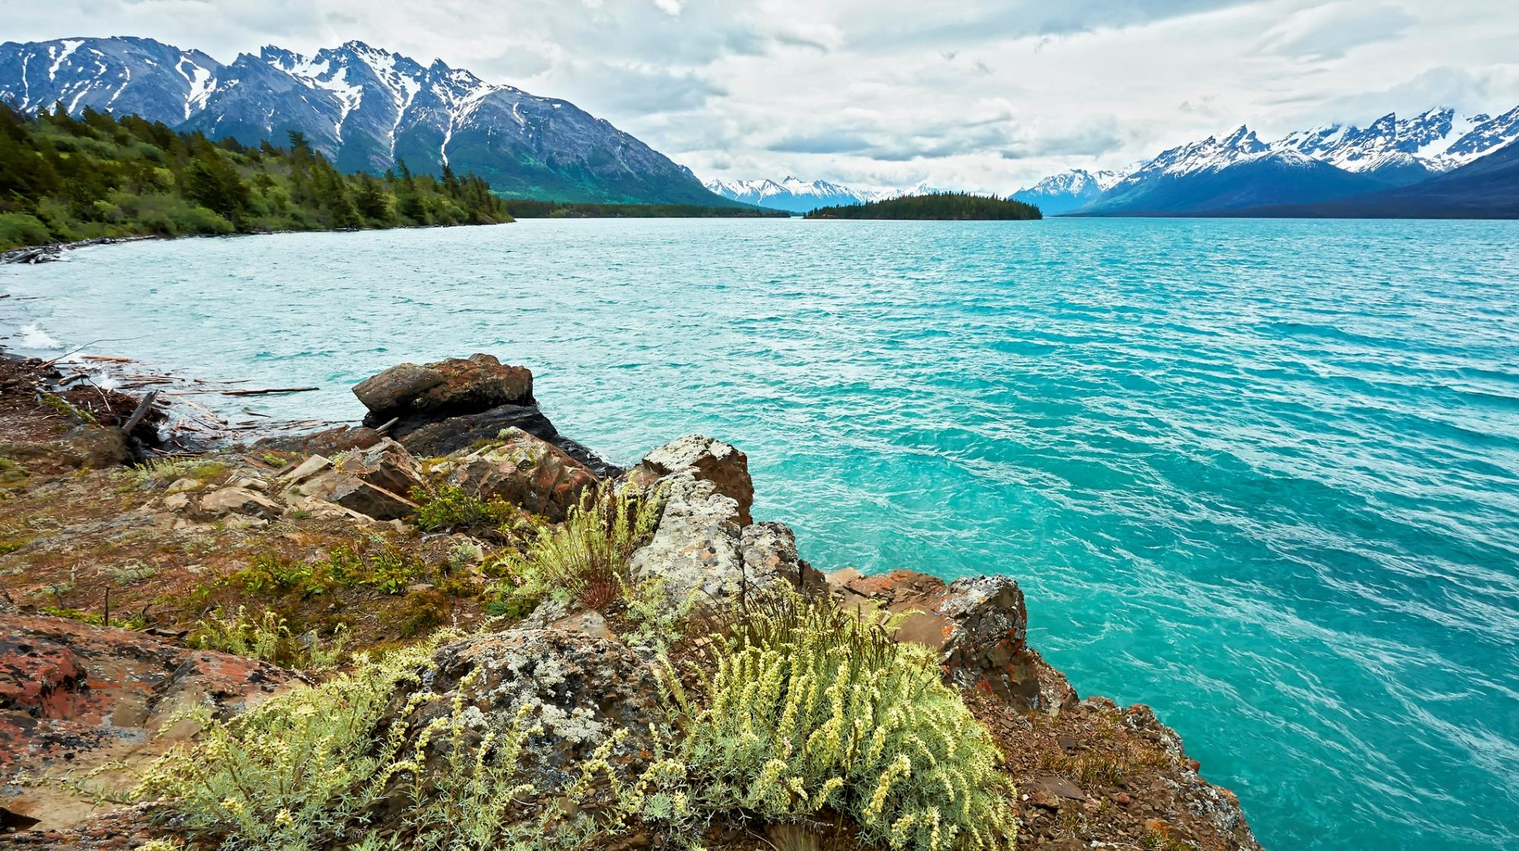

TNG-led response to the Tŝilhqox (Chilcotin River)
Landslide on Salmon
Fraser and Approach Salmon Fisheries Forum #3 , April 01, 2025
Notes:
Abenanas, Good morning.
I’d like to start with a few acknowledgments:
Thank you for the welcome this morning, and the Secwepemc people for allowing this business to be conducted in their Territory this week.
I’d also like to acknowledge my boss and TNG Fisheries Department Manager Randy Billyboy for attending in person today and supporting the presentation and discussions.
Finally, thanks to the Forum planners for this time on the agenda.
This presentation is one iteration in a series of presentations TNG Fisheries has been doing this year, and this one is focused on TNG’s leadership response to the land slide and we appreciate having the time to provide you with a thorough update as we approach the fishing season. Our update today will include:
The recognition of the Tsilhqotin Territory as a salmon stronghold and what this means
Overview of the slide event itself, as it relates to fish
TNG’s leadership response to-date, related to fisheries.
Slide impacts on salmon in 2024 - what we know.
Ongoing impacts we anticipate from the slide in coming years.
What we are doing and planning to respond and mitigate the impacts on salmon.

Slide 2
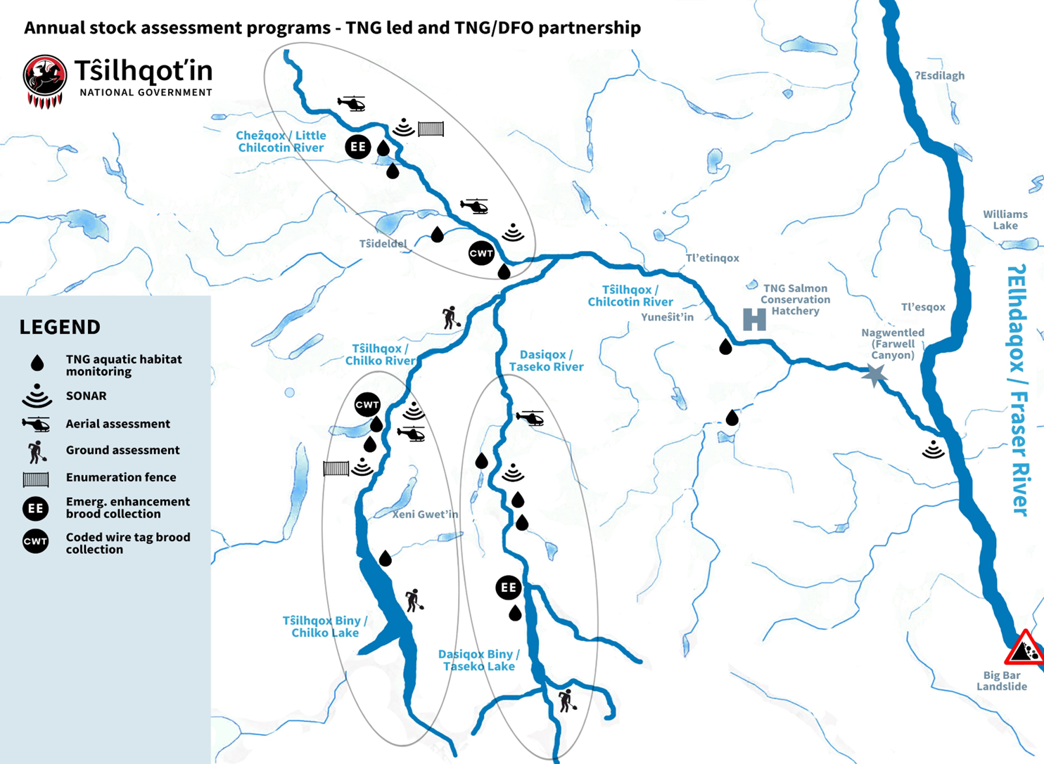
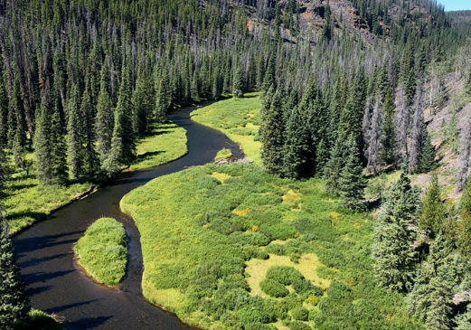
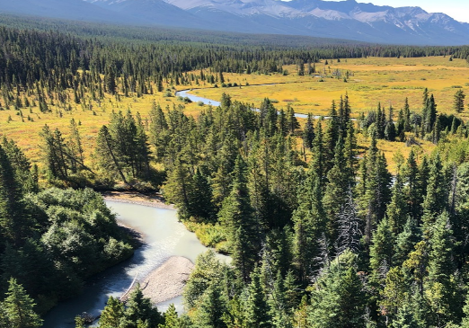
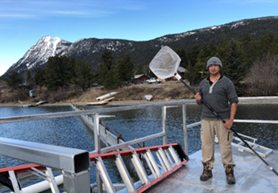
The Tŝilhqot’in Territory is a Recognized Salmon Stronghold
Stocks of significance
Salmon biodiversity is the foundation for the Tŝilhqot'in Nation’s food fishery.
One of the strongest sockeye runs in North America spawns in Tŝilhqot’in Title lands.
Intact ecosystems
Headwaters of all three major tributaries are salmon nurseries.
Two critical spawning systems, the Chilko and Taseko, have near pristine nursery grounds.
One of the richest datasets in BC TNG Fisheries conducts year-round monitoring and research programs from land, water and air to support decision making.
Notes:
The definition of a salmon stronghold has 3 main components, the first 2 of which are outlined on this slide: intact salmon biodiversity and intact and functional ecosystems
Salmon biodiversity is the foundation for the Tŝilhqot'in Nation’s food fishery. Timing of returns span from early May (early-timed Chinook) through until Nov (coho and steelhead).
Salmon Biodiversity
5 distinct populations of Chinook within two SMU’s
A sub-population of IFC
3 distinct populations of sockeye, including the strongest annual Fraser Sockeye population
Chilcotin River Steelhead
Pink salmon on odd years
Read slide for intact ecosystems and datasets

Slide 3
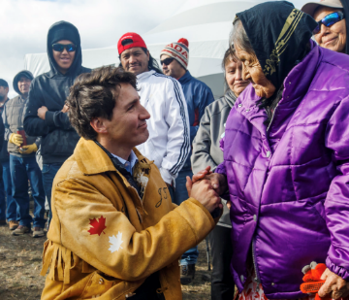
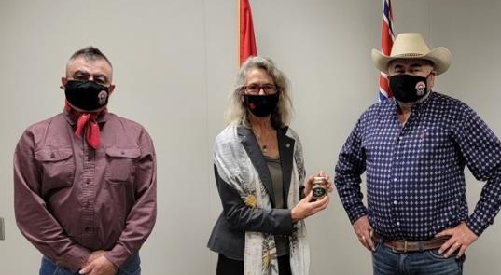
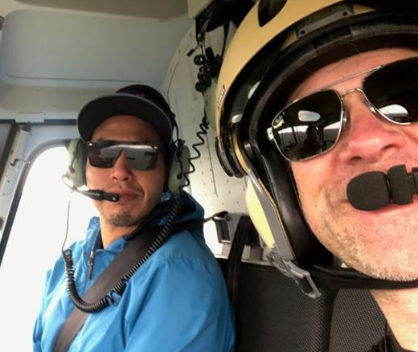
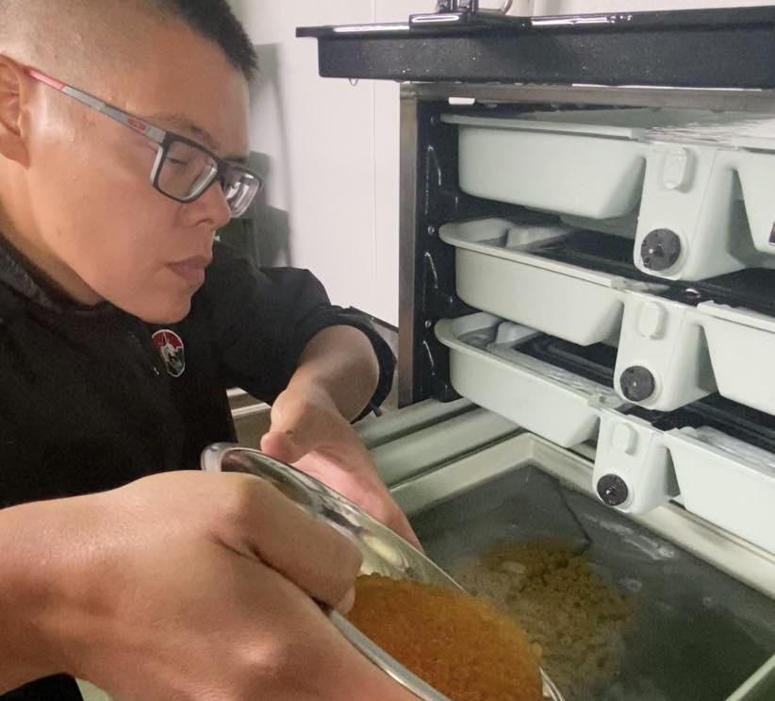
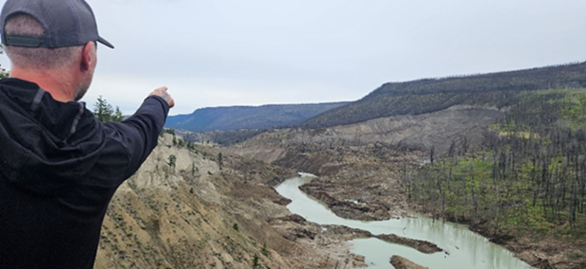
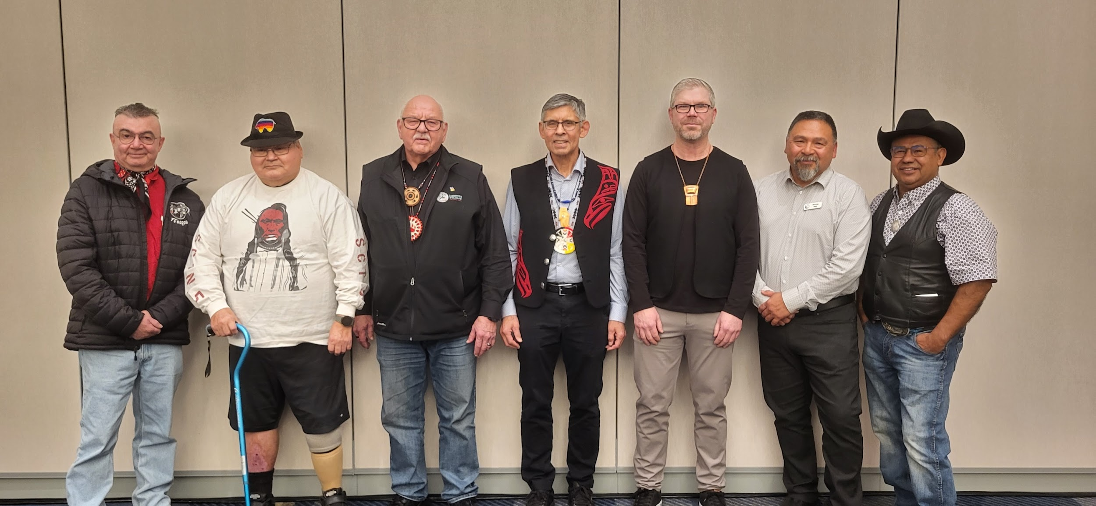
Tŝilhqot’in Nation-led Decision Making
Demonstrated commitment to having a direct and meaningful role in the governance and management of fish, fish habitat and fisheries, both within and outside of the Territory.
Prime Minister Justin Trudeau in
Tŝilhqot’in Territory (Nov 2018)
Tŝilhqot’in Leadership, Chief Frances Laceese and Chief Joe Alphonse, meeting with former Fisheries Minister Joyce Murray in Ottawa (Nov 2021)
Chilcotin salmon have faced unprecedented challenges in recent years. The Tŝilhqot'in Nation is responding to crises and leading recovery.
Tŝilhqot’in Leadership with PSC Commissioners and First Nations Caucus
Responding to crises, leading recovery
Notes:
The Third salmon stronghold component is governance/stewardship.
This is a Key component of salmon stronghold – governance (leadership and communities that actively work to protect stronghold/partnerships).
Read text and pics

Slide 4
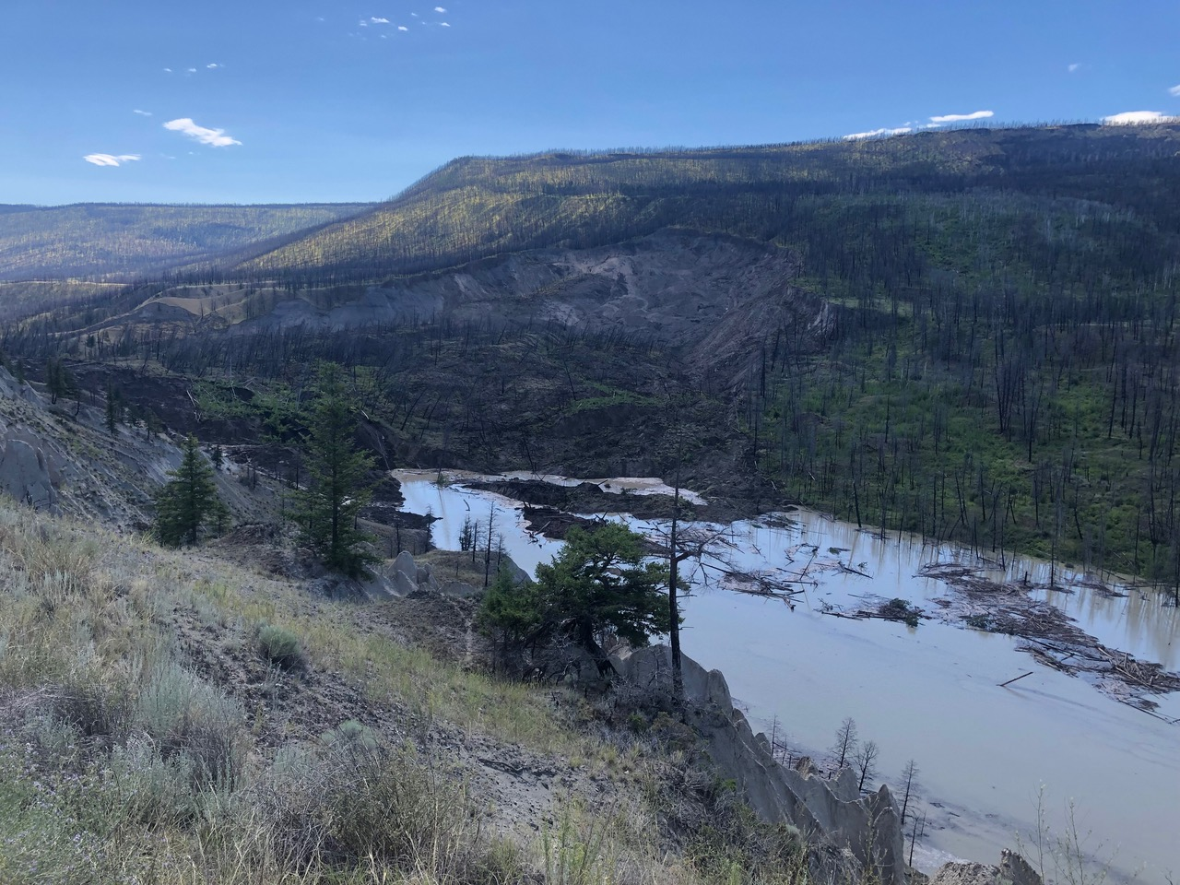
Tŝilhqox (Chilcotin) Landslide: A significant event
Large landslides are relatively common in the Chilcotin watershed.
The impacts from the 2024 landslide, impoundment and breakout flood appear to have been significant and unique.
On July 30, a landslide blocked the Chilcotin River – full-head blockage hillslope to hillslope approx. 600m across, 30m deep.
The slide occurred downstream of all sockeye and chinook spawning grounds, during their key migration window.
July 31, 2024 - 12 hours after slide event
Notes:
Large landslides are relatively common in the Chilcotin watershed. However – the impacts from the 2024 landslide and breakout flood appear to have been significant and unique.
On July 30 , a landslide blocked the Chilcotin River – full-head blockage hillslope to hillslope approx. 600m across, 30m deep.
The slide occurred downstream of all sockeye and chinook spawning grounds, during key migration window.
Pic – this photo was taken approx. 12 hours after the slide event – you can see where the slope has given way, and moved right across the river, moving entire forest right across. And water is already backing up.

Slide 5
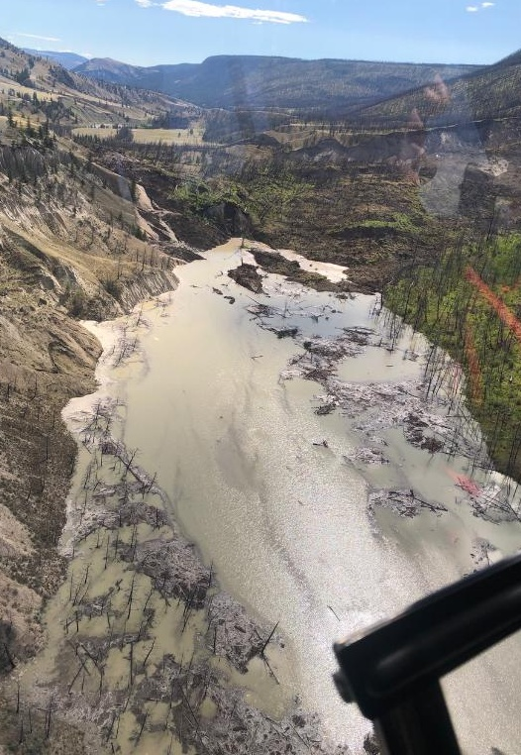
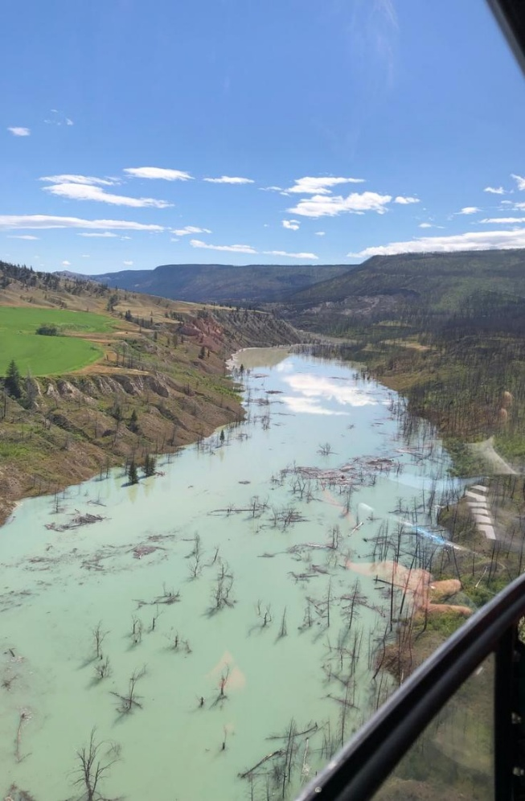
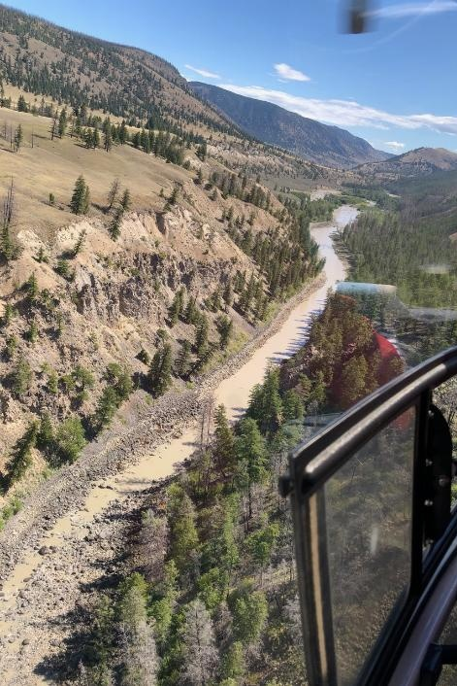
2024 Tŝilhqox (Chilcotin) Landslide: Impoundment and dewatering
The water blocked by the slide filled the river valley, forming a lake (impoundment) that extended approx. 11km upstream
The lake inundated the river’s banks and hillslopes which are largely fine soils, resulting in extensive sloughing of hillslopes and wood/debris accumulation into the temporary lake
Downstream, the Chilcotin River was completely de-watered from July 30-Aug 5, except for minor inputs from downstream tributaries
Notes:
Read text, and photo captions.
Photos left to right:
Dam and impoundment
Large impoundment formed, with extensive debris in the lake.
Downstream of dam – dewatered Chilcotin River

Slide 6
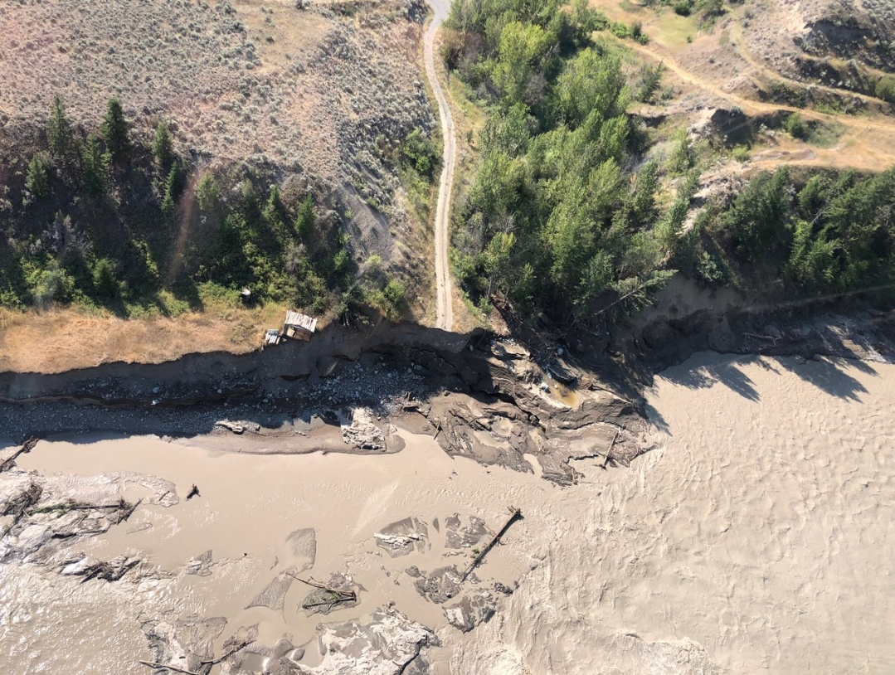
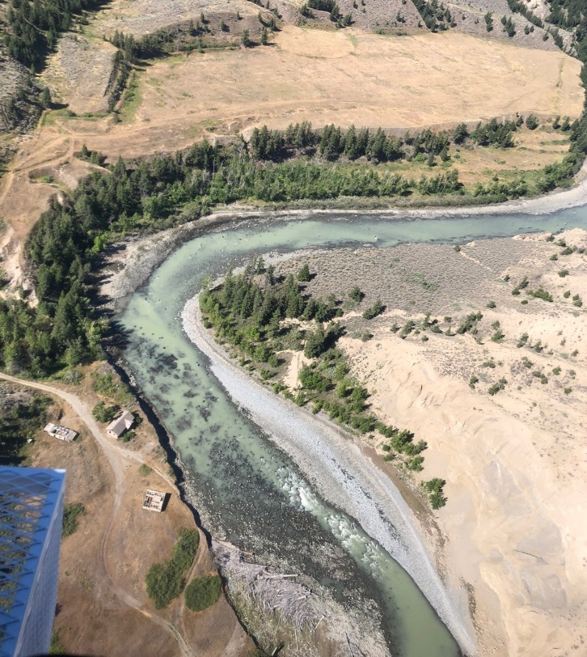
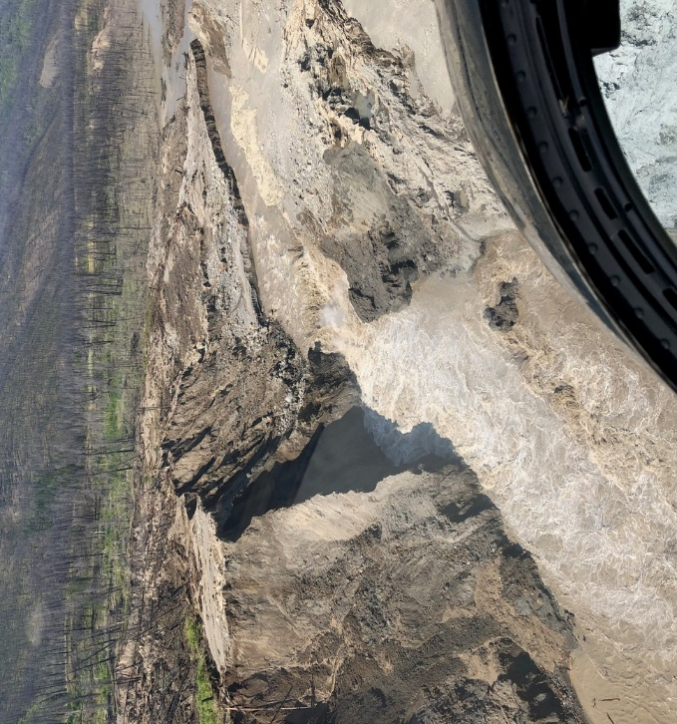
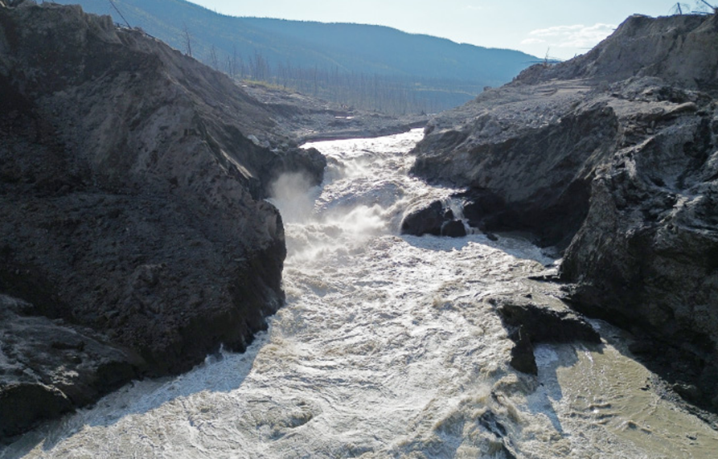
Breakout Flood - an extreme event
  On Aug 5th, 6 days after the landslide, the impounded water (lake) breached the dam. Within hours, the river exceeded typical peak freshet levels.
  The estimated peak of the breakout flood was ~4x the 1 in 1000-year flood level, making it an extreme event.
  The flood waters were heavily laden with logs and woody debris – the equivalent of 2.5M dump trucks were moved by the flood.
Before
After
After
After
Notes:
the two top photos are a before and after – you can see the “pothole ranch” just upstream from Farwell Canyon before breakout flood, and then you see what has been washed away.
the two bottom photos show breakout flood

Slide 7
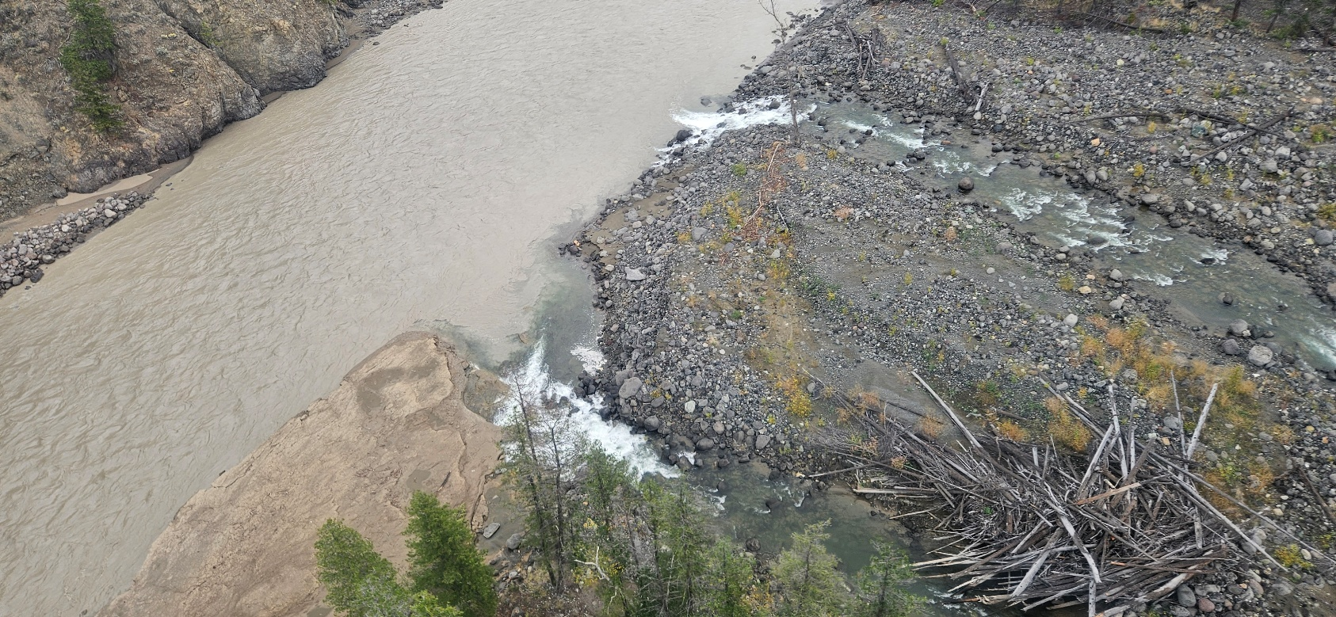
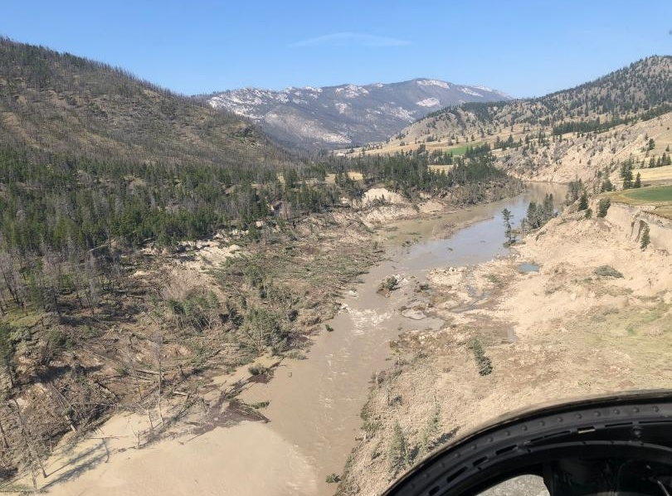
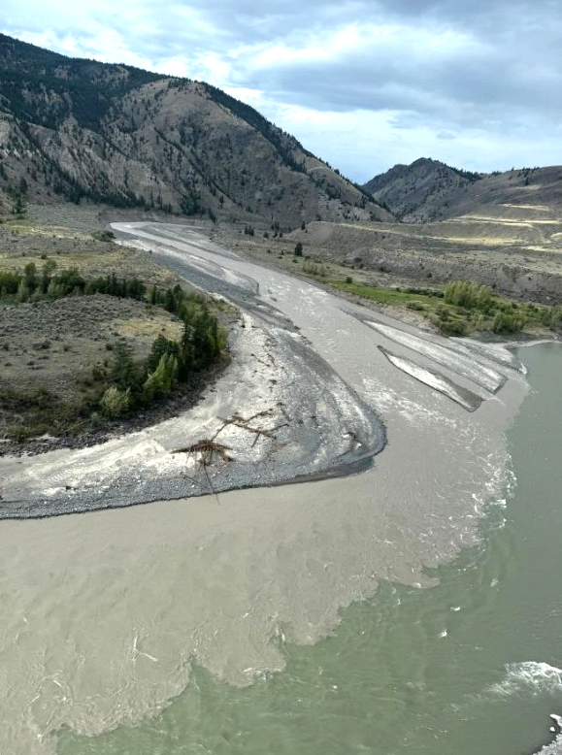
Post-breakout flood
  The extreme high flows and debris from the breakout flood created massive erosion, destabilization and recontouring in the river channel downstream of the dam.
  Turbidity levels in the Chilcotin River below the slide remained consistently high until a gradual decrease started in late Aug.
  Following the breakout flood, remobilization of slide debris resulted in two subsequent river blockages on Sept. 16 and 18 (both breached within 24 hours), resulting in temporary downstream dewatering and spiked turbidity post-breach.
Notes:
This is what happened:
Read slide:
Photos left to right:
TOP: downstream of slide - big creek confluence, see sockeye densely packed into confluence, cleaning gills
BOTTOM LEFT: upstream of slide (impact of impoundment) – not even 2 km upstream of slide (right side -is a ranch – that is where we had major sloughing a week after breakout flood – created another blockage.
BOTTOM RIGHT: Chilcotin/Fraser confluence – fish were passing through this.

Slide 8
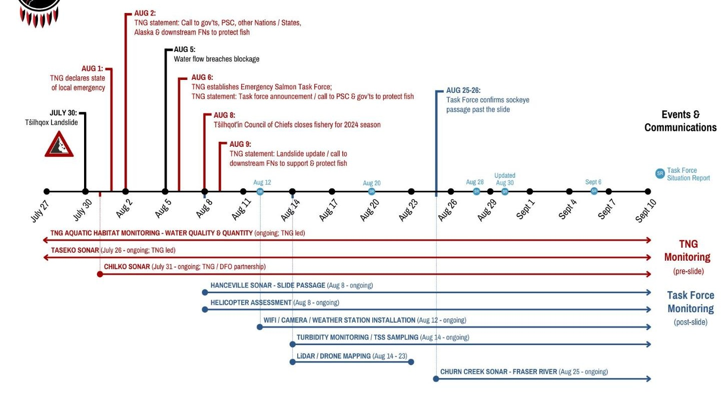

TNG Leads Collaborative Landslide Response
Notes:
This is a timeline from when the slide occurred until early Sept.
Black shows key slide dates, including the establishment of the TNG Emergency Salmon Task Force on Aug 6, the day after the breakout flood.
Red is TNG actions
Blue is taskforce.
The slide occurred during peak migration for sockeye and chinook.

Slide 9
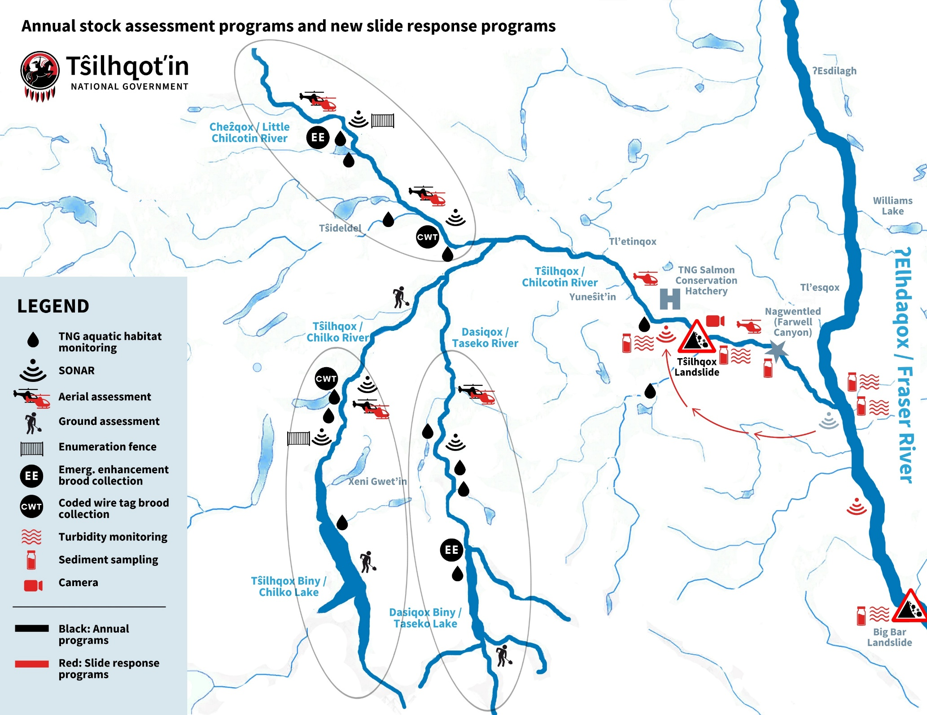
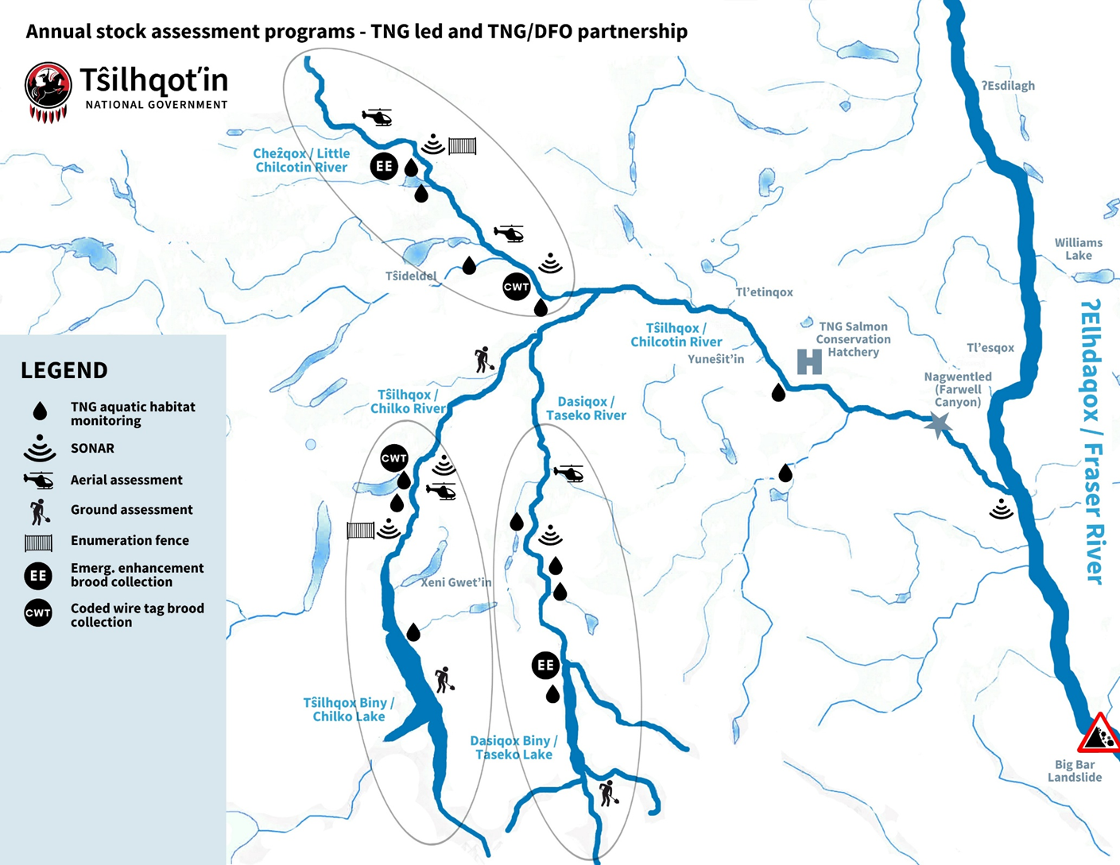
TNG-led Emergency Salmon Taskforce
TNG initiated a tri-partite collaborative table - TNG, DFO and BC
Established of critical monitoring programs of fish passage past slide area and environmental conditions.
In-season assessment of mitigation options.
Regular public reports on conditions, salmon passage.
TNG’s leadership resulted in a highly responsive, collaborative and technically rigorous process - ongoing. Currently -
Post-season analysis to understand impacts of the slide event on salmon.
Looking forward- 2025 and beyond.
Notes:
What is the TNG Emergency Task Force? This is a table of governments with overlapping authorities also supported by the UFFCA – the regional AAROM body with direct Big Bar experience and supporting communications with Upper Fraser First Nations.
TNG’s coordination has supported a collaborative approach – inviting technical expertise through the entire process. At the same time, advancing change.
Read slide

Slide 10
TNG-led Emergency Salmon Taskforce
TNG initiated a tri-partite collaborative table - TNG, DFO and BC
Established of critical monitoring programs of fish passage past slide area and environmental conditions.
In-season assessment of mitigation options.
Regular public reports on conditions, salmon passage.
TNG’s leadership resulted in a highly responsive, collaborative and technically rigorous process - ongoing. Currently -
Post-season analysis to understand impacts of the slide event on salmon.
Looking forward- 2025 and beyond.
Notes:
This was a table of governments with overlapping authorities.
TNG’s coordination has supported a collaborative approach – inviting technical expertise through the entire process. At the same time, advancing change.

Slide 11
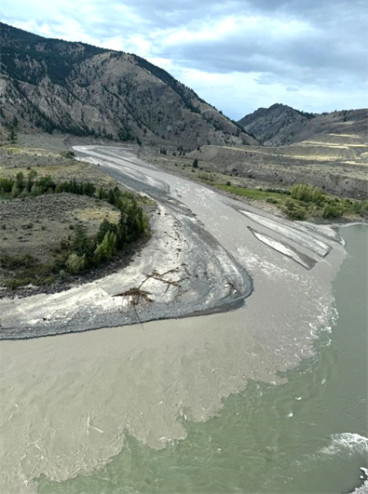

Impacts on salmon
What we saw/experienced in-season
  Major turbidity – key barrier, resulting in holding and delayed fish.
  As turbidity dropped, fish were able to pass without assistance, as predicted.
  Observed physically impacted fish
  Evidence of mortalities downstream of spawning areas.
  Subsequent sloughing/dewatering events causing physical barriers
Very tough fish – after weeks of delay, many sockeye and chinook returned to spawning grounds when turbidity levels dropped.
Notes:
Pic 1 – Chilcotin river confluence with the Fraser in early Sept. when sockeye and chinook were passing – can see how turbid it is.
Pic 2 – This pic is from Sept.6 – could see sockeye crammed into the confluence of Big creek – cleaning their gills.

Slide 12
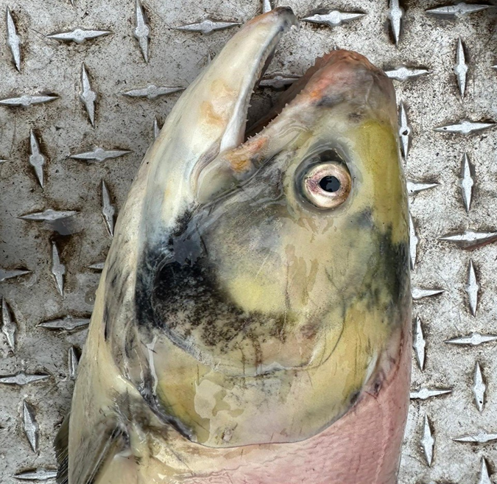
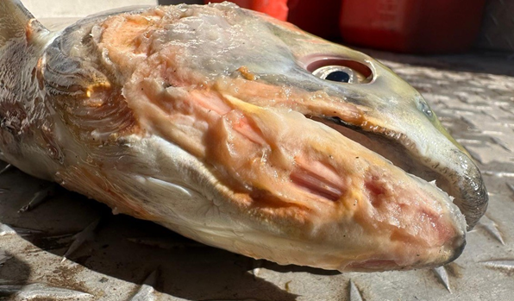
What we have learned about
2024 impacts on salmon
Impacts on early-timed sockeye (Taseko and South-end Chilko) was extreme
Chilko sockeye - ~3 week delay
  En route mortality impact – 50% loss from ocean return in-season estimate to spawning grounds (much higher than typical)
  Females impacted more than males: 30% Females, 70% Males
  Significant physical damage - sandblasted by turbidity
Chilko Chinook – ~2-3 week delay, impacts being assessed
Later timed stocks (coho, steelhead) - impacts being assessed
Effects from the landslide on salmon are cumulative (e.g. very high Fraser River temp, very low Chilko sockeye year)
Notes:
Impacts on Chilko sockeye – ~3 week delay
En route mortality impact – 50% loss of Chilko sockeye from ocean return in-season estimate to spawning grounds
Sex ratio skew: 2024 30% Females, 70% Males (inverted from 2023)
Generally higher proportion of females than males in Chilko for past 6 years:
Exceptions are when real significant passage challenge. 2019 (big bar), 2024 (hot Fraser, Chilcotin slide).
Significant physical damage - sandblasted by turbidity

Slide 13
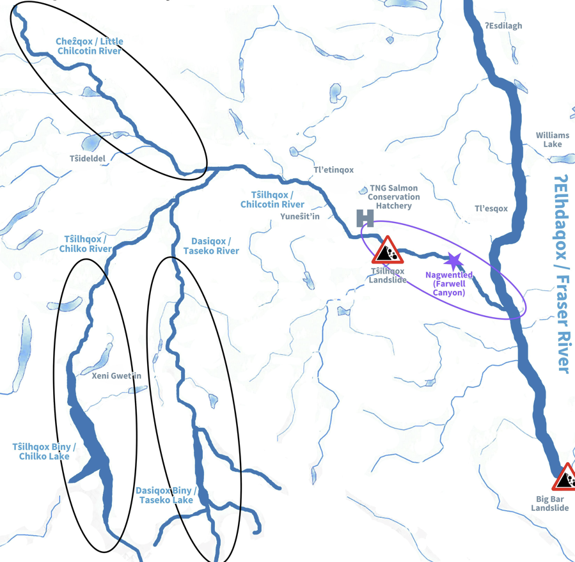
Future impacts moving forward
We are now starting to understand the future impacts from the slide and breakout flood on fish.
We know that the most significant impacts from the landslide may be still be ahead of us.
Effects assessments to-date find two major sources of impacts to fish:
Ongoing sloughing/hillslope failures from destabilization/erosion throughout impact area (top of impoundment to Fraser confluence) for coming years as system stabilizes
High rockfall risk at Farwell Canyon (imminent – when, not if))
OUR FOCUS - What do these future risks pose to salmon?

Slide 14
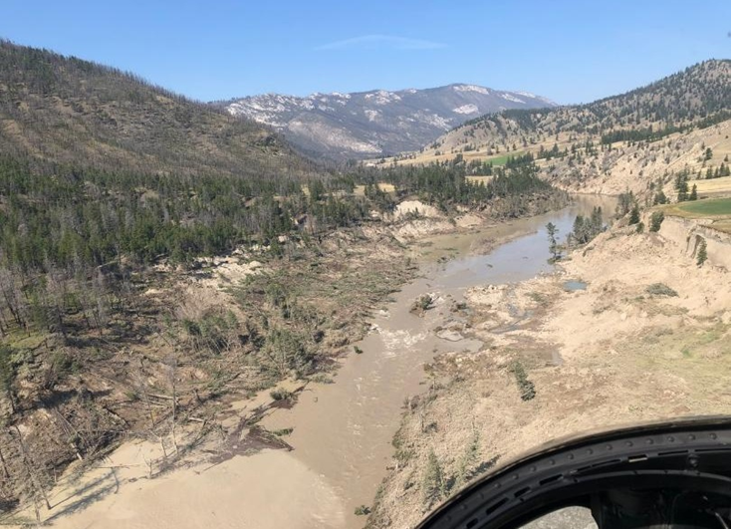

Turbidity, Flow and Habitat Impacts throughout Slide Impact Area
From the top of the impoundment, to the Fraser confluence, the impact area has experienced significant erosion and hillslope destabilization (ongoing movement of soil and woody debris, not huge rocks).
Erosion and hillslope failures will occur over coming years as the system stabilizes, that is anticipated to result in:
  Ongoing Increased turbidity in the system that makes it hard for fish to breathe and see, causes physical damage and overall stress and block migration at high levels (e,g blocked migration in Fraser River).
  Potentially Full river blockages that result in dewatering for a period of time, impacting migration and removing habitat.
  Overall ongoing changes to river ecology/function – e.g. areas filled with sediment.
Ongoing changes can potentially impact all salmon species at multiple life stages:
  Rearing and migration for all species
  Spawning and incubation for pinks (spawning areas near Farwell bridge)
  Overwintering for steelhead.
These ongoing changes to river ecology will have cumulative impacts on salmon.

Slide 15
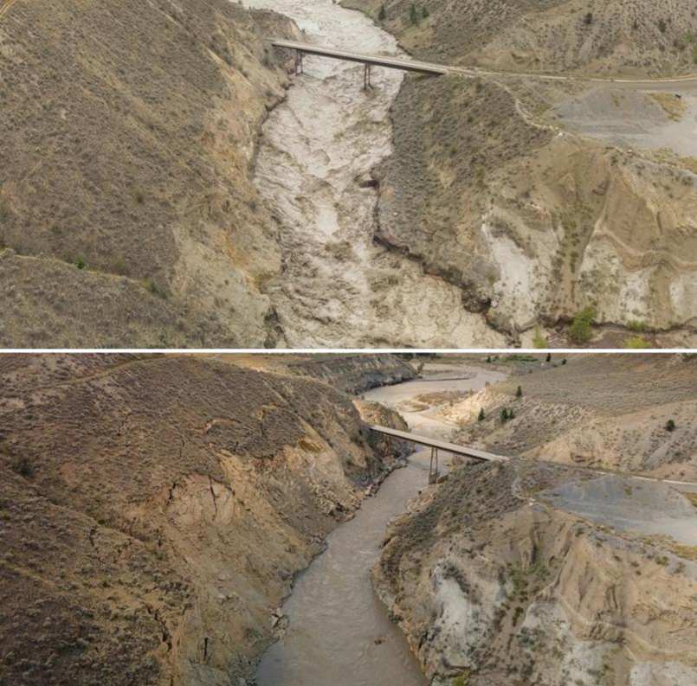
Risks to Fish Passage from Rockfall at Farwell Canyon
BGC report - Erosion at Farwell Canyon has resulted in a high risk of hillslope failure and rockfall in the short-term
Farwell Canyon already a challenging area for salmon to pass and central traditional fishing site – further taskforce-led assessment indicates rockfall risk poses high risk of impediments to salmon passage past Farwell that may include:
  Increased flow/angle
  Hydraulic drop (water fall barrier)
Gradients of impacts, from full blockage to cumulative impacts (delays, stress, reduced returns) and different impacts on different species.
Rockfall impacts on fish passage more like Big Bar – very huge rocks will just stay there, blockages not resolved over time by itself like sediment (moved by water).

Slide 16
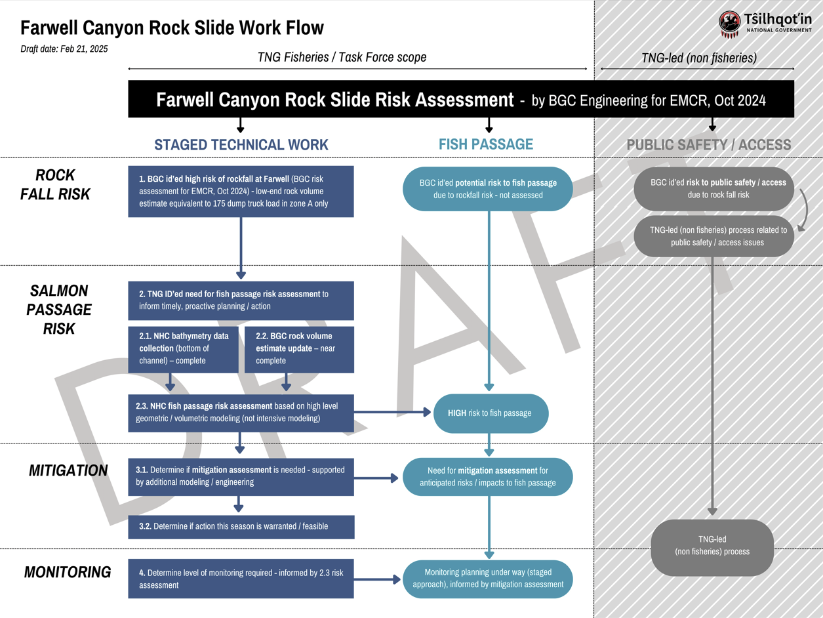
TNG/Taskforce Priority Focus
Oct. 2024 BGC report for BC found high risk of rockfall at Farwell Canyon in short-term.
TNG/taskforce conducted additional geotechnical/ hydrological work to assess risk to salmon passage.
Assessments indicate high risk of impediment to salmon passage.
We have developed priority scopes of work :
  Rockfall monitoring scope of work
  rockfall mitigation assessment
Connected with the TNG EM team to advance funding for these urgent, priority pieces of work
Notes:
Read slide

Slide 17

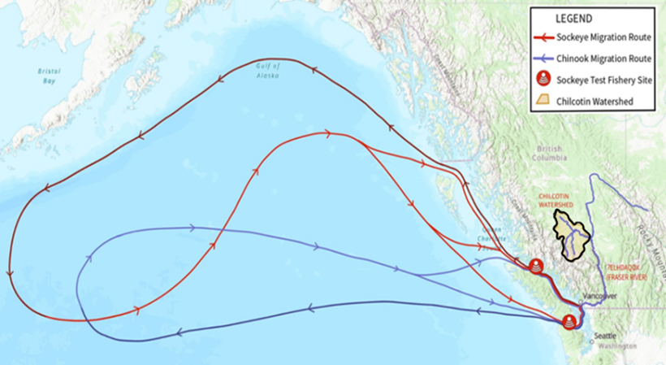
Broader ongoing TNG-led Taskforce
The risks and impacts of the slide on Tŝilhqox (Chilcotin River) salmon are not over – the most significant impacts may be ahead of us.
TNG and collaborative taskforce continue to work intensively to:
  Assess the ongoing potential risks to all salmon species with full life cycle lens
  Identify feasible mitigation and management options - for full life cycle .
  Continue, adapt and expand existing monitoring programs.
  Continue to advocate at highest levels for focus, action and resourcing to address this ongoing impact – e.g. TNG leadership at PSC (Feb 2025)
Notes:
Note TNG taking over monitoring this year, doing assessment for mitigation. Modifying activities in context.

Slide 18
PREPARING FOR 2025 SEASON
2025 preliminary fisheries forecast:
  anticipated Chilko sockeye salmon return supports a traditional fishery
  Anticipate sockeye/Chinook opportunity on Fraser mainstem
  This is also a pink salmon year (mainstem and Chilcotin)
Planning for ongoing slide response for 2025:
  Monitor from ocean to spawning grounds, now including slide impacts
  Assess suite of mitigation options
  Prepare for specific responses that may be needed - both within territory (e.g. emergency enhancement) and outside of the territory (change downstream fishing)
Supporting Tŝilhqot’in access to fisheries in 2025:
  Led by Paul Grinder and the TNG Rangers with support from Randy. Considerations include include:
    Communications
    Support to access alternative sites (infrastructure support, road access).

Slide 19
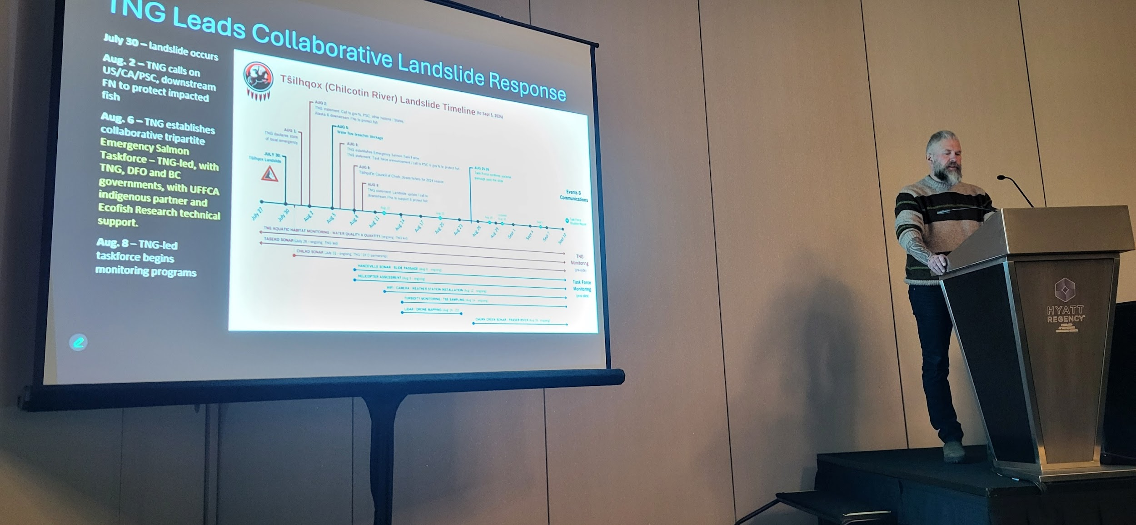
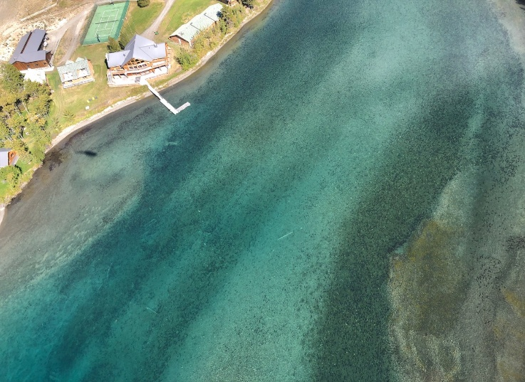
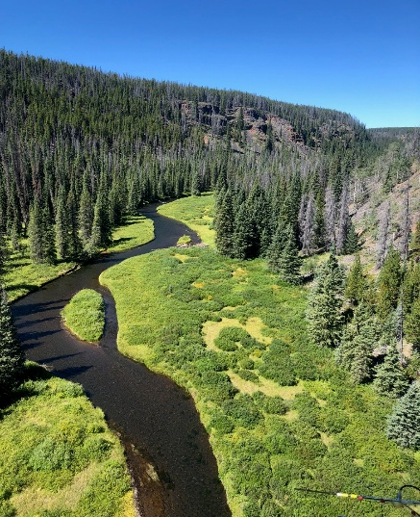
Responding to Crisis, Leading Recovery
Tŝilhqot'in Nation’s perspective bring whole salmon life cycle lens to response –
  Unparalleled knowledge of territory and fish – not siloed
Responsive, timely, nimble.
Collaborative approach with governments to support cooperation and technical rigour - AND
Advocacy at every level to change how things are done – from impacts in the ocean to protection of every stock that returns to the Territory.
Already high profile recognition of TNG’s leadership
TNG requires ongoing resourcing and focus required over next years
Notes:
What we are focused on now – understanding impacts and risks to salmon moving forward.
Show how TNG engaged PSC internationally – elevated this to very high level.
Why could tNG do this – open to collaboration, but not looking to do things the way it has aways been done. Not only going to react- already looking to next fishing season. This slide include pic of
PICS:
PSC Seminar series presentation can be found on the PSC Youtube channel (#25)
looking down at 10s of thousands of spawning sockeye - Chilko Lake lodge upper left
Upper Little Chilcotin - Home of very early returning Chinook

Slide 20
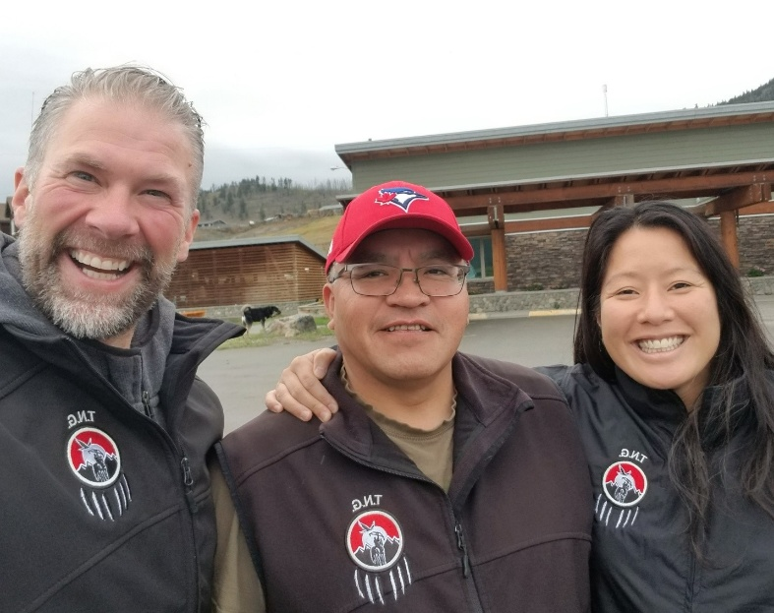
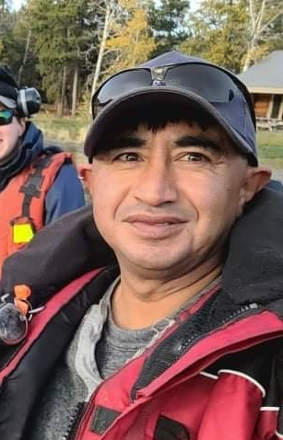
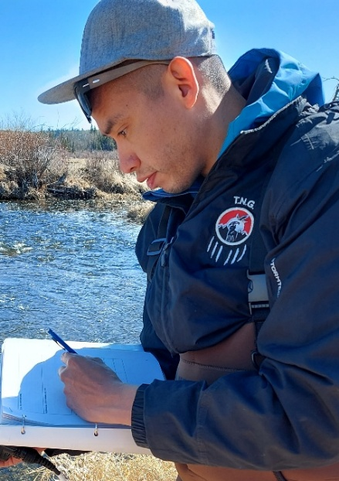
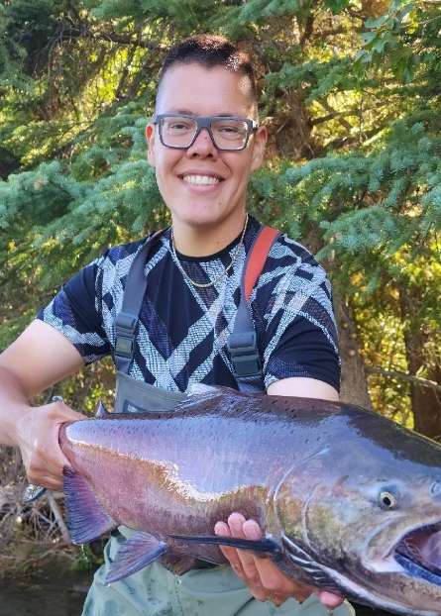
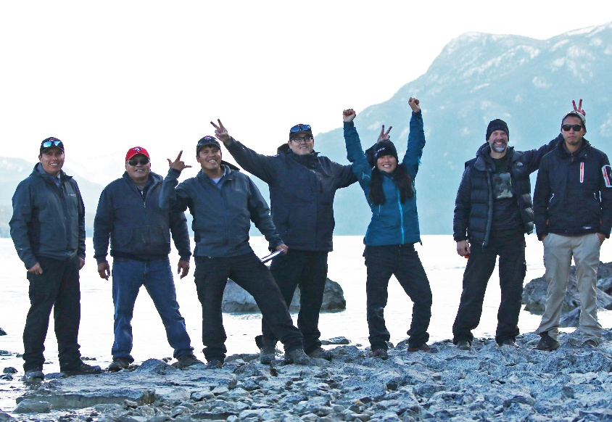
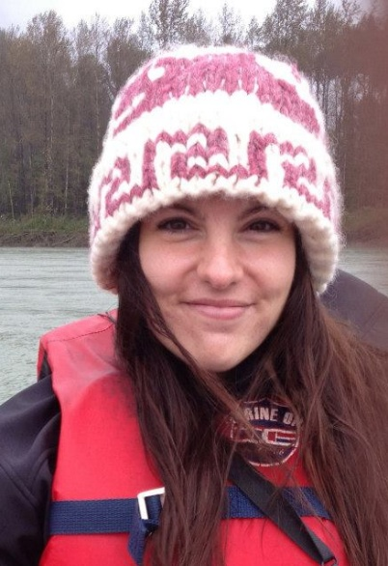

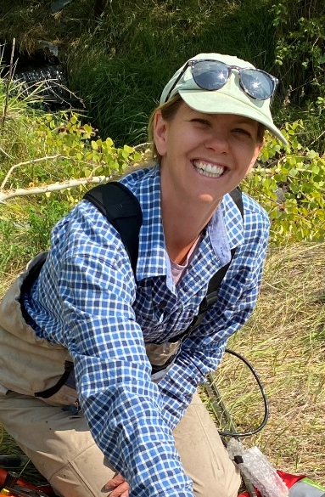
Sechanalyagh / Thank You
Thank you to members of the TNG-led Taskforce – TNG, DFO and BC governments, Indigenous partner UFFCA, and technical support from Ecofish Research.
TNG Fisheries Team and TNG Rangers

